Slide 1



KNOWLEDGE SERIES:
CONSUMER CREDIT FUND
Hao Nguyen

Slide 2

What is a managed pool of loans?
Credit risk is with the corporate
The corporate has skin in the game as they are co-invested
Loans assessed by certified & regulated credit officer
More detailed assessment criteria
Investment Risk diversified across entire pool of loans
Monthly distributions, biannual redemptions
Higher and Set returns

Slide 3


Peer-to-Peer lending without the banks
Estimated global marketplace lending
can reach $290 billion by 2020 (base case)
300
250
123% Expected CAGR
2014-2020
200
150
123% CAGR
Australia
China
UK US
100
2010-2014
50
0
2010
2011 2012 2013 2014 2015 2016 2017 2018 2019 2020

Slide 4
Peer-to-Peer Lending and how it works?
Supporter 1
(Lender)
Online Peer-to-Peer Lending
Platform bundles lender funds and issues loan to borrower for full amount
Supporter 2
(Lender)
Borrower
Creates loan requests
Receives loan proceeds
Supporter 3
(Lender)

Slide 5
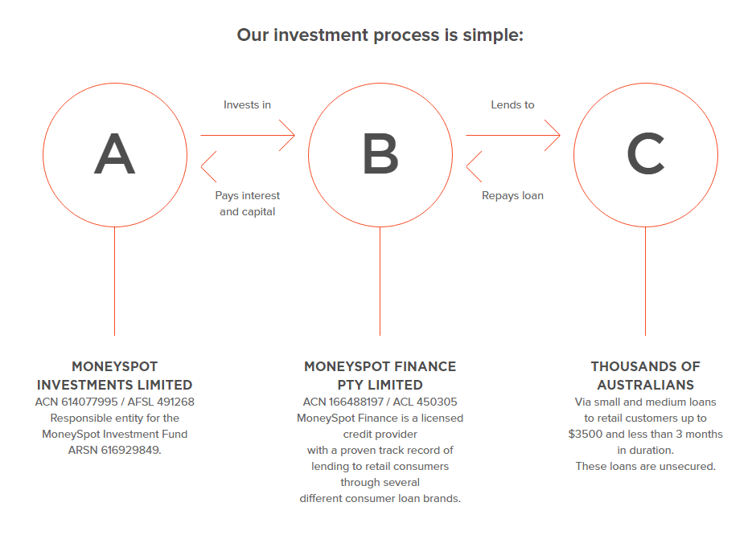
Moneyspot Investment Fund Process

Slide 6


MoneySpot Investment Fund ARSN 616 929 849
AFSL 491 268
ACL 450 305
Registered MIS
Retail and Wholesale
Invest.moneyspot.com.au
PDS and online application
Continue……

Slide 7
MoneySpot Investment Fund Features
Pooled portfolio of consumer loans
01
04
Not required to select individual loans
Diversifies risk
02
05
Independent Custodian and Fund Administered by One Investment Group
Fully managed
03

Slide 8

How Do We Compare to Other P2P Lenders
7
Consistently higher returns
Credit risk is with the corporate
1
The corporate has skin in the game as they are co-invested
2
6
Monthly distributions, biannual redemptions
What is a managed pool of loans?
3
5
Investment Risk diversified across entire pool of loans
Loans assessed by certified & regulated credit officer
4
More detailed assessment criteria

Slide 9
Began in May 2017
Monthly MoneySpot Investment Fund Performance:

Slide 10
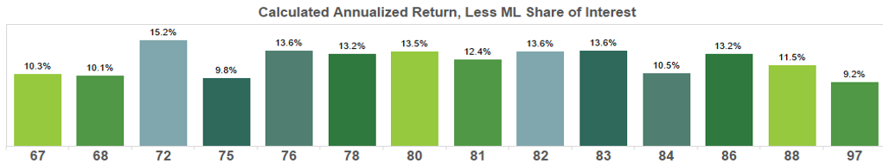
Began in October 2015
Via the MarketLend P2P Platform for businesses

Slide 11
The pool is comprised of:
01
  +40,000 active borrowers
  Individual debts less than $1,000
02
03
  All falling due within 4 months
  Regular repayments via direct debit
04
05
  Paying 4% per month on the principal lent

Slide 12
The Loan Pool
100% Online
+40,000
Number of live customers
+20,000
applications per month
+85,000
Number of loans to date
3.6%
Default rate, and dropping
74%
Repeat customers per month
+$60m
Funds lent to date
90%
Collected in 30 days
Automated credit assessment & repayments

Slide 13
Lending Criteria
Must be employed. 71% of customers have been with their current employers for over 12 months.
Customers whose main source of income is a pension, government benefits or workers compensation are not eligible.
The most recent 90 days of bank transaction data for the applicant’s income account is required.
The average after-tax customer income $59,000 per annum
On average customer repayments constitute 10% of their net income per pay cycle
There must be zero credit defaults >$300 last 2 years, judgements or bankruptcies
All applicants are matched against a proprietary database for fraud

Slide 14
Loan Book by Industry Sector

Slide 15
Customer Repayment Frequency
Monthly
13%
Weekly 39%
Fortnightly 48%
Each repayment is made up of 76% principal and 24% interest

Slide 16
Why do customers use this product?
Online 24/7
Direct debited against salary
Convenience
Set repayment schedule with
beginning and end

Slide 17
Origination
.

Slide 18
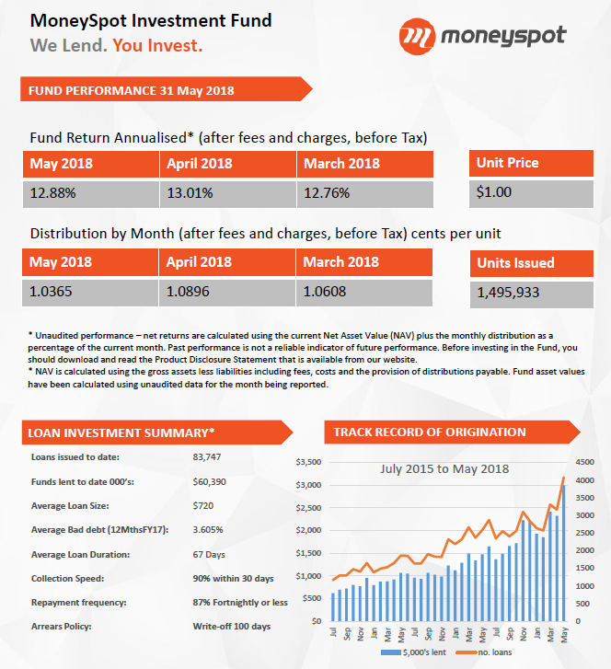
Recent performance:

Slide 19
QUESTIONS?

