Slide 1

Macro investment outlook
MAY 2017
Shane Oliver
Head of investment strategy and Chief economist

Slide 2
The noise continues
      Fed taper talk
      Syria
      US Government shutdown and debt ceiling debacle
      End of US QE
      Ukraine
      IS terror threat
      Ebola
      Deflation
      Commodity/oil crash
      Greece
      China worries – shares, debt, property, currency
      Worries about Australian recession, property crash, banks
      Brazil & Russia in recession
      Worries about energy producers defaulting
      Manufacturing slump globally
      Trump
      Worries about Fed raising rates/rising $US
      Soft starts to the year for US growth
      Falling profits
      Brexit
      Messy Australian election result
      South China Sea tensions
      An attempted coup in Turkey
      Italy, Austria, the Netherlands, France
      North Korea
Source: AMP Capital

Slide 3
Shares still trending up
Source: Thomson Reuters, AMP Capital
Notes:
Last Updated: 2 May 2017
Excel File: F:CALLUM/STRATEGY/Analysis and data/asx vs shcomp.xls
Chart: Chart 2

Slide 4
Nine rules for investors to keep in mind
      The power of compound interest
      There is always a cycle – bear markets happen
      Invest for the long term – consider goal based investing if you can’t
      Diversify
      Turn down the noise
      Buy low and sell high – selling after a 20% fall just locks in a loss
      Beware the crowd at extremes – shares bottom at the point of maximum bearishness
      Focus on investments providing decent, sustainable cash flows & investments you understand
      Seek advice
Source: AMP Capital
Notes:
4

Slide 5
The power of compound interest
Source: Global Financial Data, AMP Capital
Notes:
5

Slide 6
The investment cycle
Inflation becomes a problem, rate fears
Economic
Slowdown
Property does well
Economic
Recovery
Equities do well
Govt bonds do well
Current position
Source: AMP Capital
Notes:
6
Last Updated: 07 MAY ‘09

Slide 7

Beware the crowd – the magazine cover index
2009. Brazilian shares around all time high (73,000)
2013. Brazilian shares around 45,000.
Now around 65,000
Source: The Economist, AMP Capital
Notes:
7

Slide 8
Economic and investment outlook
      Okay global growth – 2017: 3.3%, 2018: 3.4%
      2017 GDP growth. China 6.5%, US 2.5%, Eurozone 2.0%, Japan 0.8%, Australia 2.6%
      Interest rates to remain low, expect 3 Fed rate hikes this year but the ECB, BoJ and RBA on hold
      $US headed gradually higher, $A still headed down - but bulk of weakness is behind us
      Term deposits offer low returns and likely further capital loss on bonds
      Shares at risk of a short term pull back, but should provide decent returns on a 6-12 month view as global growth improves
      Key risks: US policy under Trump, the Fed & $US, rising bond yields, Eurozone break up worries, China, the Australian property market, North Korea
Source: AMP Capital

Slide 9
Global growth forecasts stable or improving
Source: IMF, AMP Capital
Notes:
FILE NAME: F:/TRINH/SIGNPOSTS v1.xls
CHART: C-INTERESTRATES(2)
Last updated: 8 Oct 15

Slide 10
Global business conditions have improved
  Manufacturing PMIs pointing up…
  …as are services PMIs
Source: Bloomberg, AMP Capital
Notes:
f/taa models/PMI_Sam.xls chart = chart 2(2)
f/taa models/PMI_Sam.xls chart 2
Last updated: 2 May 2017

Slide 11
The US economy good, not booming
Further fed rate hikes likely – but rising $US will constrain
  US employment way above 2008, jobless
  well down, nearing full employment
  Consumer confidence strong and capex indicators picking up after losing some ground
Source: Bloomberg, AMP Capital
Notes:
CALLUM\STRATEGY\Analysis and data\US jobs – Payrolls and UR – UPDATE after Friday?
CALLUM\STRATEGY\Standard market analysis charts\US activity indicies – updated 3 May 2017
Last updated 10 April 2017

Slide 12
Normalisation of the fed’s balance sheet
Tapering of reinvestments to start end of 2017, but is conditional on growth & inflation outcomes
Source: Bloomberg, AMP Capital
Notes:
Diana/Central Bank Balance Sheets/Sheet 1
Last updated 3 May 2017

Slide 13
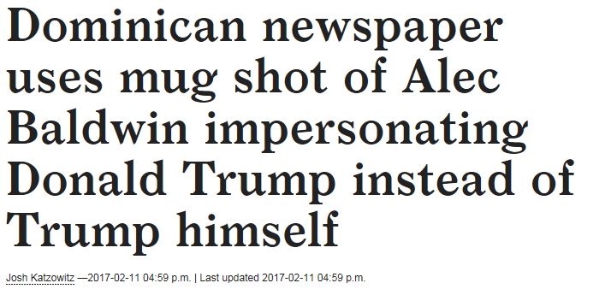

Hard to separate fact from comedy
Source: Gallup, BCA Research, AMP Capital

Slide 14
Trump the pragmatist is dominating trump the populist
      The twitter avalanche continues and risks remain but President Trump has moved towards the mainstream:
      Tough stance on Syria and North Korea (no American isolationism)
      Worse relationship with Russia
      Working with China on North Korea, trade (no “currency manipulator”)
      Selective use of tariffs and industry studies (no trade war)
      He likes low rates and Fed Chair Yellen (no stacking the Fed with hawks)
      Meanwhile he remains focussed on his business friendly policies - tax cuts, deregulation, infrastructure
Source: AMP Capital

Slide 15
The Eurozone looking good
Source: Bloomberg, AMP Capital
Notes:
F: /brendan/charts/global PMIs.xls Chart = Europe (3)
Last updated: 3 May 2017

Slide 16

What about Brexit and Europe?
Source: AMP Capital

Slide 17
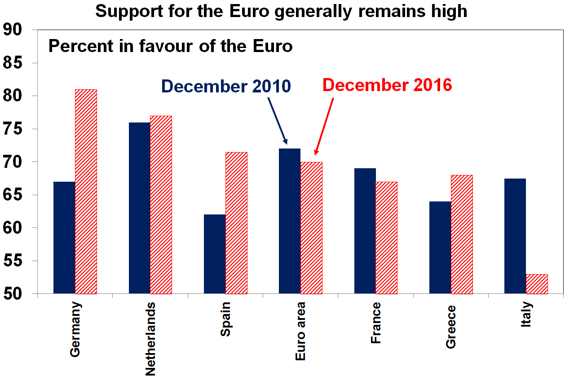
Eurozone break up risk
  Key issues and what to watch
  Support for Euro remains strong (Italy excepted)
Brexit uncertainty remains - but the UK economy is only 2.5% of global GDP
Post Brexit elections in Spain, Austria, the Netherlands & France showed “poor” results for anti-Euro populists.
Italy is a bigger risk
Why Eurozone break up risk is overstated: less inequality, support for Euro is generally high
A Eurosceptic win in an individual country would not necessarily lead to an exit from the Euro
Source: Eurobarometer, AMP Capital
Notes:
f/shane/eurozone – support for populists
Last updated: 8 March 2017

Slide 18
Japanese growth looking a bit better
Bank of Japan targeting above 2% inflation
Source: Bloomberg, AMP Capital
Notes:
F: /brendan/charts/global PMIs.xls Chart = Japan (4)
Last updated: 3 May 2017

Slide 19
Chinese growth has picked up
Stimulus giving way to modest tightening
  Chinese growth has stabilised
  China is in transition from manufacturing & investment to services & consumption
Source: Thomson Reuters, Bloomberg, AMP Capital
Notes:
F:/BOB/CHINA ECON DATA.XLS
CHART: 2
3 May 2017
F:/callum/strategy/standard market analysis charts/global macro bbg China Maco View – Chart7
Last updated: 3 May 2017

Slide 20
Geopolitical risk – watch list
Event | Potential impact | Significance | Probability/ Assessment
Eurozone elections: France (June), Germany (Sept), Italy (Feb 2018?) | Fear of Eurozone break up | High | Low
UK election (June) | Impact on Brexit | Low | Low
US politics – ACA reform, tax reform, debt ceiling increase, Trump risks | Hit to US confidence | High | Low
Ongoing IS terror threat | Economic disruption | Medium | Low
South China Sea escalation | War | High | Low-Medium
Trade war between US & China | Economic disruption | High | Low
Korean tensions | War | High | Low-Medium
Source: AMP Capital

Slide 21
Spare capacity remains which is keeping underlying inflation low
Source: Bloomberg, AMP Capital Investors
21
Notes:
21
F: Bob\capmoney.xls Chart 1
Last updated: 3 May 2017

Slide 22
Interest rates to remain low, but us on the way up
Source: Thomson Reuters, Bloomberg, AMP Capital
Notes:
FILE NAME: F:/TRINH/SIGNPOSTS v1.xls
CHART: C-INTERESTRATES(2.1)
Last updated: 4 May 2017

Slide 23
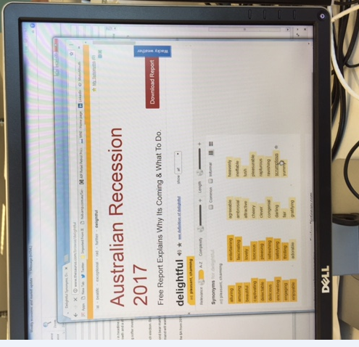
Beware the perennial calls for recession
Source: AMP Capital

Slide 24
The Australian economy
Still motoring along
  Housing investment is set to slow
  …and retail sales growth is sluggish
  But mining investment is close to the bottom
  …and services exports are strong
Source: ABS, AMP Capital
Notes:
Building Approvals
F/AustEc/aus_building.xls > Building Approvals (3)
4 May 2017
Retail Sales
F/AustEc/aus_retail.xls > Retail sales
4 May 2017
F/AustEc/Aus CAPEX – Combined Chart (2)
1 March 2017
Confidence
F/Bob/AUSTBOND/Confidence – Invest Pack
Last updated: 5 Apr 2015
Services exports:
AustEc – Australia education and tourism exports Char1
4 May 2017

Slide 25
A budget surplus for 2020/21 still expected but revenue projections are ambitious given soft wages growth and commodity price risks
Source: Federal Treasury, AMP Capital
Notes:
Last updated: 3 Feb 2016
TAA Models/Equity/Valuations

Slide 26
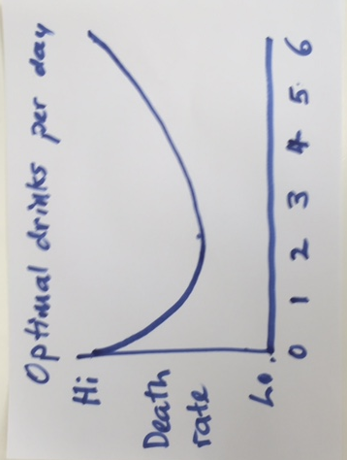
Optimal drinks per day – dr John
Source: AMP Capital

Slide 27
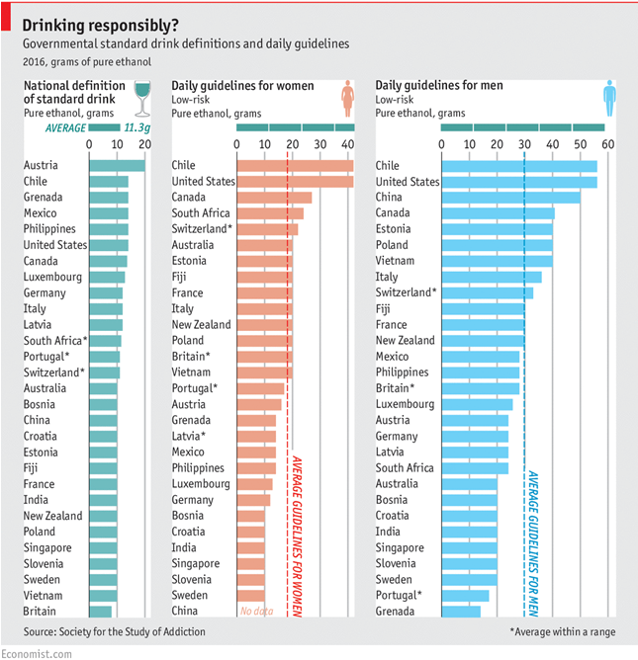
Optimal drinks per day – better move to chile !

Slide 28
Shares fair value to cheap
Share market valuation indicators
Source: Thomson Reuters, AMP Capital
Notes:
Last updated: 5 May2017
TAA Models/Equity/Valuations

Slide 29
Australian shares are still offering a high cash flow versus bank deposits
Source: Bloomberg, AMP Capital
Notes:
Last updated: 3 Feb 2016
TAA Models/Equity/Valuations

Slide 30
Aust Listed company profits are seeing a return to growth this financial year
Source: UBS, AMP Capital
Notes:
f/shane/profits_eps_Australia listed
Chart3
3/3/17

Slide 31
Bonds at the end of a 35 year bull market
Yields have so far just had a flick off the bottom
Source: Bloomberg, AMP Capital
Notes:
Excel File: F:richard\graphs\LT 10yr bond yields AU US.xls – Chart1(4)
Last updated: 5 May 2017

Slide 32
the “search for yield” is likely to weaken and become more selective
Source: RBA, AMP Capital
Notes:
Excel File: F\Diana\direct_property.xls chart-yields(10)
Nader/Charts/Direct Property
Last updated: 5 May 2017

Slide 33
The Divergent Australian housing market
Sydney and Melbourne still too hot
Source: Core Logic-RP Data, Domain APM, AMP Capital
Notes:
f/austec/home prices_RP Data.xlsx Chart 3 – May 2017
f/trinh/auction clearance rates.xlsx Chart (Clearance Month) – May 2017

Slide 34
Crash calls for Australian property? Expensive housing & high debt but undersupplied
Source: ABS, RBA, AMP Capital
Notes:
Jan 2017
f/austec/house_LT

Slide 35
Heading for a short term oversupply of apartment's though = significant price risk
Source: Rider, Levett, Bucknall Crane Index, AMP Capital
Notes:
3 Mar 2016
f/austec/home building/cranes

Slide 36
The $A is likely to see more downside
  The $A usually overshoots
Source: Bloomberg, AMP Capital
Notes:
RHS: f/austec/spolt/chart1.(2.1)
Last updated: May 2017

Slide 37
Traffic light signals from DAA process
Signal | Equities | Listed property | Fixed income | Commodities
Valuation
Cycle
Liquidity
Sentiment
Technical
Result | Favourable | Neutral | Negative | Neutral
Source: AMP Capital. As at May 2017.

Slide 38
Dynamic asset allocation
Dynamic Markets Fund
  Change in growth/defensive mix
  and hedge ratio
Allocations | Range (%) | Current AA (%)
Growth | 0 – 90 | 67.0
Australian Shares | 0 – 50 | 14.5
International Shares (Developed Markets) | 0 – 50 | 31.5
International Shares (Emerging Markets) |  | 5.0
Global REITs | 0 – 25 | 0.0
Commodities | 0 – 25 | 16.0
Global High Yield Credit | 0 – 25 | 0.0
Defensive | 10 – 100 | 33.0
Australian Sovereign Bonds | 0 – 25 | 3.0
Global Sovereign Bonds | 0 – 25 | 0.0
Global Investment Grade Credit | 0 – 25 | 0.0
Global Inflation Linked Bonds | 0 – 25 | 0.0
Cash & Hedges | 0 – 50 | 30.0
AUD exposure (% of total fund) | 0 – 100 | 71.0
Current AA as at May 2017.

Slide 39
Economic and investment outlook
      Okay global growth – 2017: 3.3%, 2018: 3.4%
      2017 GDP growth. China 6.5%, US 2.5%, Eurozone 2.0%, Japan 0.8%, Australia 2.6%
      Interest rates to remain low, expect 3 Fed rate hikes this year but the ECB, BoJ and RBA on hold
      $US headed gradually higher, $A still headed down - but bulk of weakness is behind us
      Term deposits offer low returns and likely further capital loss on bonds
      Shares at risk of a short term pull back, but should provide decent returns on a 6-12 month view as global growth improves
      Key risks: US policy under Trump, the Fed & $US, rising bond yields, Eurozone break up worries, China, the Australian property market, North Korea
Source: AMP Capital

Slide 40
While every care has been taken in the preparation of this document, AMP Capital Investors Limited (ABN 59 001 777 591, AFSL 232497) and AMP Capital Funds Management Limited
(ABN 15 159 557 721, AFSL 426455) makes no representations or warranties as to the accuracy or completeness of any statement in it including, without limitation, any forecasts.
Past performance is not a reliable indicator of future performance.
This document has been prepared for the purpose of providing general information, without taking account of any particular investor’s objectives, financial situation or needs. An investor should,
before making any investment decisions, consider the appropriateness of the information in this document, and seek professional advice, having regard to the investor’s objectives, financial situation and needs.
This document is solely for the use of the party to whom it is provided.

Slide 41
Projected medium term returns, %pa, pre fees and taxes
 | Current Yield # | + Hedge Points | +Growth | =Return
US Equities | 1.9 | 0.6 | 4.5 | 7.0
Asia ex Japan Equities | 2.5 | -0.7 | 7.0 | 8.8
Emerging Equities | 2.7 | -2.2 | 7.0 | 7.5
World Equities, local currencies | 2.5 | 1.1 | 4.1 | 7.6
Australian Equities | 4.2/5.4* | 0.0 | 3.5 | 7.7/8.9*
New Zealand Equities | 4.8 | -0.1 | 3.8 | 8.4
Unlisted Commercial Property | 5.8 | 0.0 | 2.0 | 7.8
Australian REITS | 4.7 | 0.0 | 2.3 | 6.9
Global REITS | 3.9 | 0.6 | 2.0 | 6.5
Unlisted Infrastructure | 5.0 | 0.3 | 3.2 | 8.5
Global Listed Infrastructure | 3.5 | 0.8 | 3.0 | 7.3
Australian Gov’t Bonds | 2.3 | 0.0 | 0.0 | 2.3
Australian Corporate Debt | 3.4 | 0.0 | 0.0 | 3.4
Australian Cash | 2.7 | 0.0 | 0.0 | 2.7
Diversified Growth Mix |  |  |  | 6.3
# Current dividend yield for shares, distribution/net rental yields for property and
5 year bond yield for bonds. * With franking credits added in
Source: AMP Capital
Notes:
May 2017
F/David/Investments/Capital Market Assumptions/Med Term/Output/Key Cap Market Forecast Table Template – Summary Column AF

Slide 42
Eurozone shares have a very low shiller PE
Source: Global Financial Data, AMP Capital
Notes:
3 Mar 2016
f/austec/home building/cranes

