Slide 1
Aged Care: Strategies and Solutions
August 2017
Josh Nissenbaum
Business Development Manager

Slide 2
This information is current as at July 2017 unless otherwise specified and is provided by Challenger Life Company Limited ABN 44 072 486 938, AFSL 234670 and Challenger Retirement and Investment Services Limited ABN 80 115 534 453, AFSL 295642 (Challenger), the issuers of Challenger’s financial products for retirement (Retirement Products). It is intended to be general information only and not financial product advice and has been prepared without taking into account any person’s objectives, financial situation or needs. Investors should, before making any investment decision, consider its appropriateness having regard to these matters and the information in the product disclosure statement (PDS) for the relevant Retirement Product before deciding whether to acquire or continue to hold a Retirement Product. Copies of the PDS’s are available at www.challenger.com.au or by contacting our Investor Services Team on 13 35 66.
Where examples, hypotheticals or case studies are used, they are used for illustrative purposes only. They are not to be relied on and do not reflect any person’s particular objectives, financial situation or needs. This information may also include statements of opinion, forward looking statements, forecasts or predictions based on current expectations about future events and results. Any such statements are subject to change and actual results may be materially different from those shown. This is because outcomes reflect the assumptions made and may be affected by known or unknown risks and uncertainties that are not able to be presently identified. The taxation, Centrelink and Department of Veterans’ Affairs (DVA) information and illustrations are based on current law at the time of writing which may change at a future date. Challenger is not licensed or authorised to provide tax, social security or DVA advice. We strongly recommend that professional taxation, social security and/or DVA advice for individual circumstances be sought. Past performance is not a reliable indicator of future performance.
In preparing this information, Challenger has relied on publicly available information and sources believed to be reliable, however the information has not been independently verified. While due care and attention has been exercised in the preparation of this information, no representation or warranty, either express or implied, is given as to the accuracy, completeness or reliability of that information. The information presented is not intended to be a complete statement or summary of the industries, markets, securities or developments referred to in the presentation. Neither Challenger nor their related entities, nor any of their directors, employees or agents accept any liability for any loss or damage arising out of the use of all or part of, or any omission, inadequacy or inaccuracy in, the information presented.
Where a person acquires or holds a Retirement Product, Challenger and its related parties will receive the fees and/or other benefits disclosed in the relevant PDS. Neither Challenger, its related entities nor their employees receive any specific remuneration for any advice provided. Financial advisers, however, may receive fees if they provide advice to you or arrange for you to invest in a Challenger Retirement Product. Some or all Challenger Group companies and their directors may benefit from fees and other benefits received by another Group company.

Slide 3
Agenda
Overview of residential aged care
The aged care process
Costs and options
The value of advice

Slide 4
Why aged care advice
Expected increase in demand for aged care
2015 Intergenerational report, and
ABS (Dec 2010)
Notes:
The number of people aged 85 and over is projected to more than quadruple (from 0.5 million to 1.9 million) between 2015 and 2055. This will drive a major increase in the demand for aged care services

Slide 5
Why aged care advice
Potential for aged care
Age | Disability free years |  | Years with some disability |  | Years with severe disability |  | Total
 | Male | Female | Male | Female | Male | Female | Male | Female
65 | 9 | 10 | 10 | 12 | 3 | 6 | 22 | 28
75 | 4 | 5 | 8 | 9 | 3 | 5 | 15 | 19
85 | 1 | 2 | 5 | 6 | 2 | 4 | 8 | 12
Just over half¹ of Australians aged 65 and over reported living with disability
Source: Australian Institute of Health and Welfare, Changes in life expectancy and disability in Australia , 2015.
1. ABS, 2015 Survey of Disability, Ageing and Carers (sample size of 75,211 persons).
Notes:
The table shows average years for a 65, 75 and 85 year old male and female where they are disability free, have some disability and have severe disability

Slide 6
Overview of residential aged care
Aged care options
Help at home
Commonwealth Home Support Programme
Aged care homes
Residential Aged Care
Respite Care
Home Care Packages
Respite Care

Slide 7
Overview of residential aged care
Various options and support for your needs
Commonwealth Home Support Programme
An entry level service to help you remain at home that can assist with daily tasks and care
Permanent Residential Aged Care
Provides support and accommodation on a permanent and respite (temporary) basis
Home Care Packages
Tailored package of services based on the level of care and services you require

Slide 8
Overview of residential aged care
Aged care facts
Residential aged care
77% of residents are aged 80 or over
68% of residents are female
19% stay for 5 years or more
87% of residents receive a Government pension¹
The most common age range for entry into aged care is 85-89
Average length of stay in aged care:
2.27 years for males
3.31 years for females
Source: Australian Institute of Health and Welfare, Residential Aged Care and Home Care 2014-15
1 Australian Institute of Health and Welfare, Residential Aged Care and Home Care 2013-14
Notes:
Average age for women in aged care is 85.8
Average age for me in aged care is 81.6
(both from same footnote #1)

Slide 9
Overview of residential aged care
Aged care facts
Category | Average Published Price RAD / DAP | Average Agreed RAD / DAP
Highest in major cities | $396,000 / $62.17 | $364,000 / $57.14
Regional areas | $335,000 / $52.59 | $295,000 / $46.31
Remote areas | $297,000 / $46.62 | $246,000 / $38.62
As at 31 May 2016, 86% of all prices published were less than $550,000; 8% were published at $550,000 and 6% were higher
In NSW the average is $378,000 however 90% are between $200,000 and $675,000
Source: Aged Care Financing Authority | Annual Report on the Funding and Financing of the Aged Care Sector 2016 provides average RADs. DAPs based on MPIR as at 1 July 2017 which is 5.73%.
Notes:
Average age for women in aged care is 85.8
Average age for me in aged care is 81.6
(both from same footnote #1)

Slide 10
Overview of residential aged care
Facts about residents
Time spent waiting for a place
10% within a week
31% within a month
58% within 3 months
81% within 9 months
Time in aged care
19% of all residents stay 5 years or more
Source: ‘Residential aged care and home care 2014-15’, Australian Institute of Health and Welfare

Slide 11
Overview of residential aged care
Common questions to consider
How do I find out about getting the right care for mum and/or dad?
Which aged care home is right for mum and/or dad?
Can we keep the family home?
What will the fees/costs be?
Do we need to pay the fees/costs as a lump sum?
How will it affect my Centrelink or DVA benefits?
What will be left for the family?
Often the move into aged care is a rushed and stressful time

Slide 12
The aged care process

Slide 13
The aged care process
Accessing residential aged care
The process of moving into residential aged care
Step 1
Step 2
Step 3
ACAT¹ assessment
Identify a suitable home
Organise finances
ACAT – Aged Care Assessment Team. Known as ACAS (Aged Care Assessment Services) in Victoria

Slide 14
The aged care process
The ACAT assessment
Assessment usually performed at your home and it is free
ACAT members are usually a nurse, social worker or other health care professional
During the assessment a family member/friend or carer can be there for support
The assessor will:
ask if you wish to apply for approval to receive certain aged care services,
ask questions about your day-to-day living activities and if you need help with any or all of them,
talk to you about whether you can keep living in your own home, or if they think you might be better supported in an aged care home and
provide information about the services available to you.

Slide 15
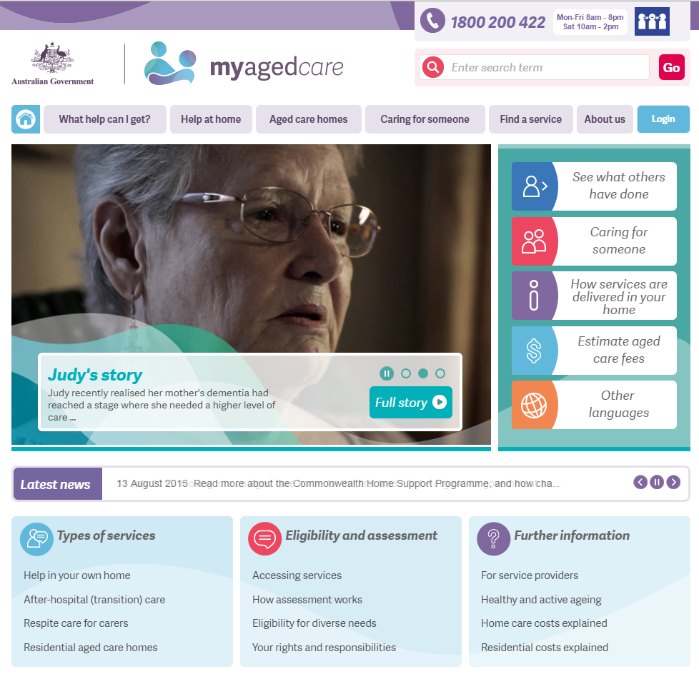
The aged care process
Finding out about services and places | www.myagedcare.gov.au

Slide 16
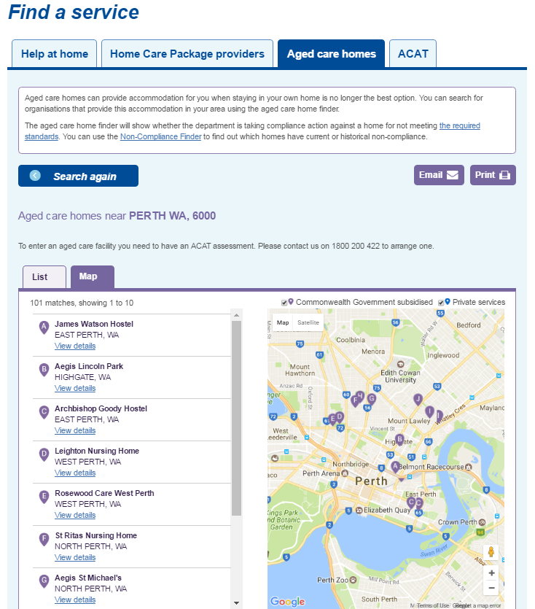
The aged care process
Finding out about services and places | www.myagedcare.gov.au

Slide 17
The aged care process
The many financial considerations
Aged care fees and charges
calculate fees
strategies to minimise fees
Family home options
keep? sell?
investing sale proceeds
Review current position
Estate planning
current investments
funding accommodation payments
death benefits
wills and enduring POAs
Centrelink/DVA
impact on Age Pension
strategies to maximise pension
Tax planning
PAYG and CGT
tax offsets

Slide 18
The costs and options

Slide 19
The aged care process
Understanding the costs
Accommodation costs
Ongoing care costs
Accommodation payments
Extra service fee
Basic
daily fee
Means-tested care fee
Amount payable based on ‘means’
Agreed with facility where an extra service is chosen
$49.07 per day Indexed half yearly (March/September)
Based on ‘means’ Annual cap of $26,381 Lifetime cap of $63,313
Based on rates as at 1 July 2017

Slide 20
Costs and options
Accommodation Payment
Aged care facilities are required to publish their accommodation prices
The published price is payable by residents who have the ‘means’. Otherwise, the amount cannot exceed their ‘means’
Residents have 28 days after date of entry to decide how to pay
The accommodation payment can be paid as a:
lump sum that is refundable, known as a Refundable Accommodation Deposit (RAD),
daily amount that is not refundable, known as a Daily Accommodation Payment (DAP), or
combination of both.
DAP can be paid or deducted from RAD

Slide 21
Costs and options
Refundable accommodation payments
Refundable lump sum
Not counted when determining Centrelink/DVA entitlement
Guaranteed by the Government
Counted when determining aged care costs
Refunded to the resident or estate

Slide 22
Costs and options
Determining ‘means’
Based on a resident’s income and asset assessment and converted into a daily amount
If the daily amount is above $55.09 the resident is considered to have the ‘means’
Residents who have the ‘means’ pay:
the published price (determined on entry) and
a means tested care fee (calculated quarterly).
Residents who don’t have the ‘means’:
Cannot be asked to pay the published price
Pay an accommodation payment based on their means; and
Do not pay a means tested care fee whilst their means is below the relevant threshold (currently $55.09)
Based on rates as at 1 July 2017

Slide 23
Costs and options
Income and assets for aged care
Assessable income for aged care
equivalent to Centrelink/DVA assessable income plus most of the pension received.
Assessable assets for aged care
equivalent to Centrelink/DVA assessable assets plus:
any refundable accommodation balance, and
the value of the former home, up to $162,087 per member of a couple, if it is not occupied by a protected person.
Based on rates as at 1 July 2017.

Slide 24
Costs and options
Common cases where a resident has the ‘means’
A resident has a former home with a value greater than $162,087 (or $324,174 if owned jointly) and does not have a protected person living there.
A resident’s assessable assets exceeds $162,087
A resident has assessable income over:
$66,282 if single, or
$65,814 if a member of a couple.
For residents who have assets and income below the above amounts, they too can still be considered to have the ‘means’ if their income assessment plus their asset assessment exceeds $55.09 per day.
Based on rates as at 1 July 2017

Slide 25
Costs and options
Example – Betty enters residential aged care
Betty is 87 years of age (widowed) and owns her own home (approx. $980,000). Betty also has:
$10,000 in personal assets,
$55,000 in cash, and
$200,000 in term deposits.
Her current Age Pension is $21,513 (approx. 93% of the maximum).
The aged care facility she wishes to go into has a published price of $400,000.
Based on rates as at 1 July 2017.

Slide 26
The costs and options
Calculating the cost
If Betty decided to keep her home and pay the published price as a daily payment then in year 1:
her Age Pension would continue to be $21,513, and
her aged care costs would be $44,642
Accommodation payments of $22,920
Based on the outstanding balance of $400,000
Basic daily fee of $17,911
Indexed twice a year, payable for life
Means-tested care fee of $3,811
Subject to an annual cap and a lifetime cap.
In year 1 there is a shortfall of $23,129 between the aged care fees and the Age Pension.
Based on rates as at 1 July 2017.

Slide 27
Costs and options
Options to fund the shortfall
There are various options to fund the shortfall. Betty could:
draw down on cash and term deposits,
rent the home, or
sell the home and invest the proceeds.
Each option will provide different outcomes for her:
cash flow,
estate planning goals,
Age Pension entitlements, and
aged care costs.

Slide 28
The costs and options
Draw down on cash and term deposits – common considerations
Paying some of the accommodation amount as a refundable lump sum can help reduce aged care costs and improve Age Pension entitlements.
Betty will lose home exemption for Age Pension purposes after two years. Her cashflow will need to be reviewed at this time.
What amount is to be retained as a cash ‘buffer’?
Who is going to be responsible for looking after the former home?
What impact will retaining the former home have on other expenses?
for example rates and utility bills.

Slide 29
Costs and options
Renting the house – common considerations
Does the property need to be ‘refreshed’? What amount of rent is achievable?
Who is going to be responsible for managing and maintaining the former home?
rental agreement
ongoing maintenance and taxes
need for a cash ‘buffer’
Impact on the capital gains tax exemption for a residence?
Impact of net rental income on Centrelink/DVA pensions and aged care fees?

Slide 30
Costs and options
Sell the house – common considerations
Betty can pay the lump sum payment after she moves into care.
What amount is to be retained as a cash ‘buffer’?
Likely to increase the level of assets for Centrelink/DVA and aged care.
Can impact the amount of income that counts for Centrelink/DVA and aged care.
Where should the proceeds be invested?
cash flow
estate planning
impact on Centrelink/DVA and aged care fees

Slide 31
Costs and options
Seeking advice can help
Financial advice can help:
improve regularity of cash flow
identify strategies that complement estate planning goals
find suitable investments to assist in:
reducing aged care fees
improving Age Pension entitlements
demystify the transition to aged care
families and residents to make an informed choice.

Slide 32
The value of advice

Slide 33
The value of advice
Benefits of seeking advice
Support through the process
Find a suitable home
Decide what to do with the family home
How to structure accommodation payments
Strategies to reduce ongoing care fees
How to fund cashflow requirements
Review estate planning

Slide 34
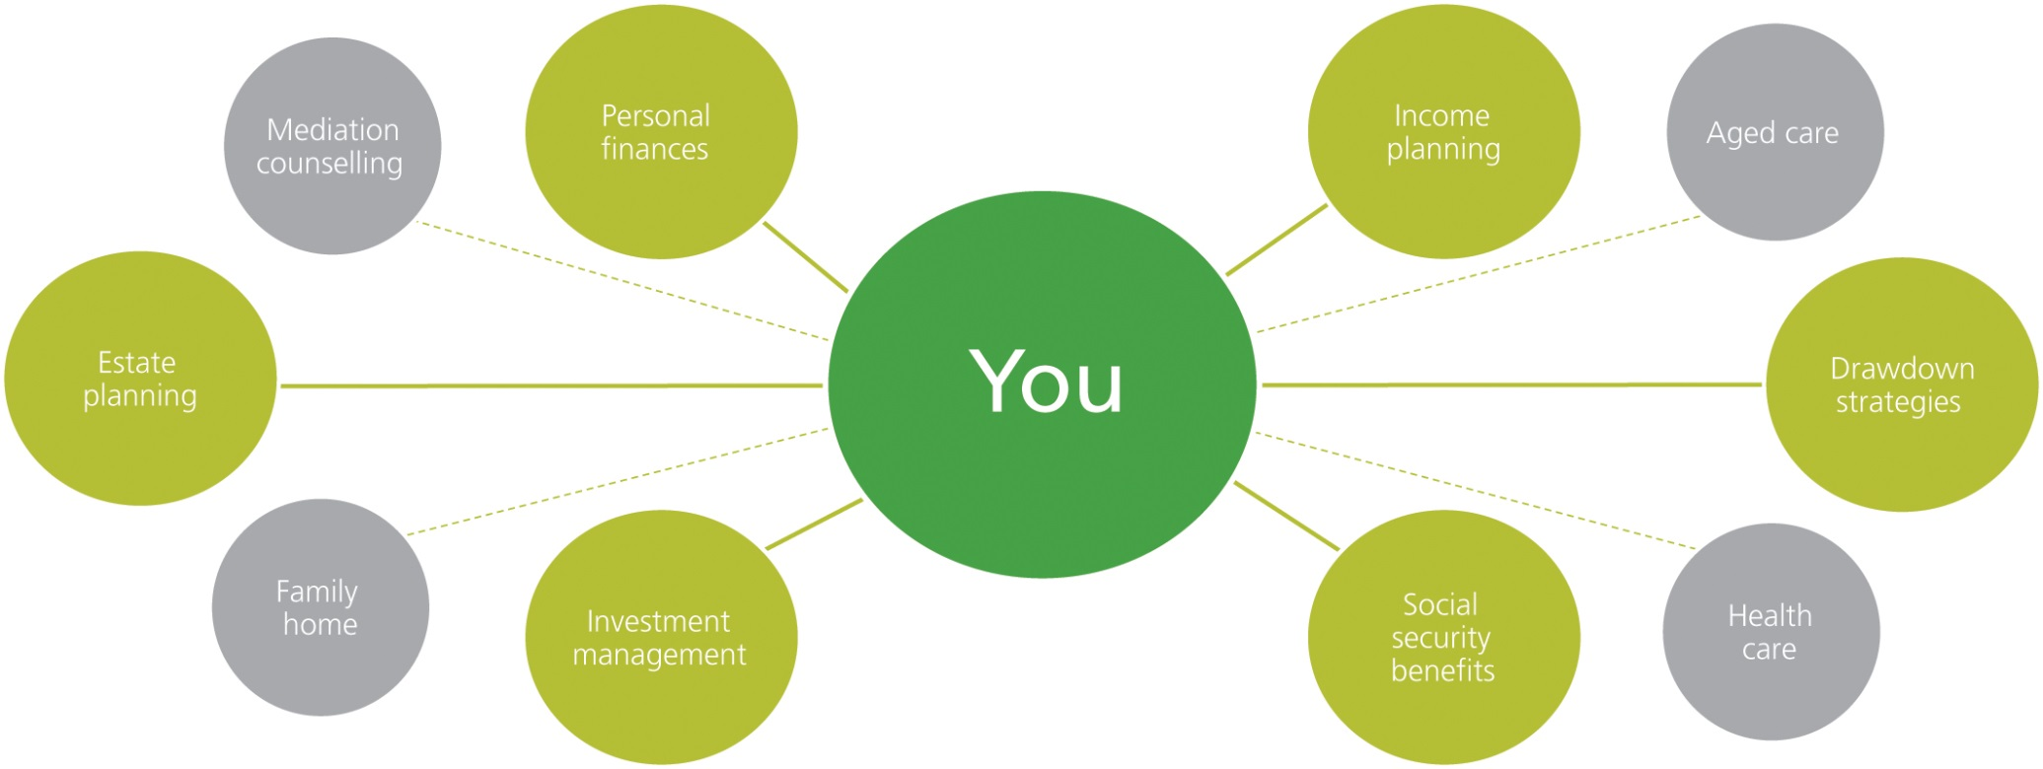
The value of advice
Financial advice covers many areas

Slide 35
Any questions?

