Slide 1
Preparing your portfolio for rate rises
David Bryant, CEO Wealth & CIO Australian Unity Group
April 2017

Slide 2
Important information
The information contained within this presentation is produced by Australian Unity Funds Management Ltd ABN 60 071 497 115 AFS Licence 234454 (AUFM) and is based upon current information believed to be accurate at the date of the presentation. Any opinions or statements or financial assumptions or projections made are reasonably held at this date, but no warranty is given as to their accuracy, reliability or the likelihood of occurrence.
The financial products listed in this presentation are issued by Australian Unity Funds Management Limited. Past performance is not a reliable indicator of future performance.
The Australian Unity Healthcare Property Trust is issued by Australian Unity Funds Management Limited ABN 60 071 497 115, AFS Licence No. 234454. Effective 8 April 2016, new investor applications and additional applications from existing investors were temporary suspended.
Wholesale Units and Retail Units in the Platypus Australian Equities Fund are issued by Australian Unity Funds Management Limited ABN 60 071 497 115, AFS Licence No. 234454. Retail Units are closed to new investors.
The information in this document is general information and it does not take into account the financial objectives, situation or needs of any particular investor. In deciding whether to acquire, hold or dispose of this product you should refer to the current Product Disclosure Statement (PDS) and consider whether the product is appropriate for you.
A copy of the PDS is available at australianunity.com.au/wealth or by calling our Investor Services team on 13 29 39. Investment decisions should not be made upon the basis of its past performance or distribution rate, or any ratings given by a rating agency, since each of these can vary. In addition, ratings need to be understood in the context of the full report issued by the rating agency itself. The information provided in the document is current at the time of publication.
This presentation must not be distributed by the recipient in whole or in part to any other person without obtaining the prior written consent of Australian Unity.
Notes:
There are no right answers
Or easy answers
Remember general advice

Slide 3
Agenda
Where have we been investing?
Where are we at now?
The question of interest rates
Where to from here?
Notes:
What the period ahead looks like
Look back how things behave when rates increase
Staying safe ….. And getting a return

Slide 4
Where have we been investing?

Slide 5
3 pillars
Bank shares
Residential Property
Term deposits
Notes:
Exposure to banks, residential property, term deposits
Growth stats:
Australian Residential Property -
Dec 11 - $4,400,528m 2006 - ~ $3tn
Dec 16 - $6,438,537m
= 46% increase over 5 years
Superannuation-
Dec 06 - $962,526m
Dec 16 – $2,137,588m
= 122% increase over 10 years
Australian deposits
Dec 05 - $828,966m
Dec 15 – $2,075,450m
= 150% increase over 10 years

Slide 6
Where are we at now?
Notes:
Transition between cycles
Easy money = over!
Low rates = ending
Inflation and growth emerging
Transition bumpy, then the next growth cycle

Slide 7
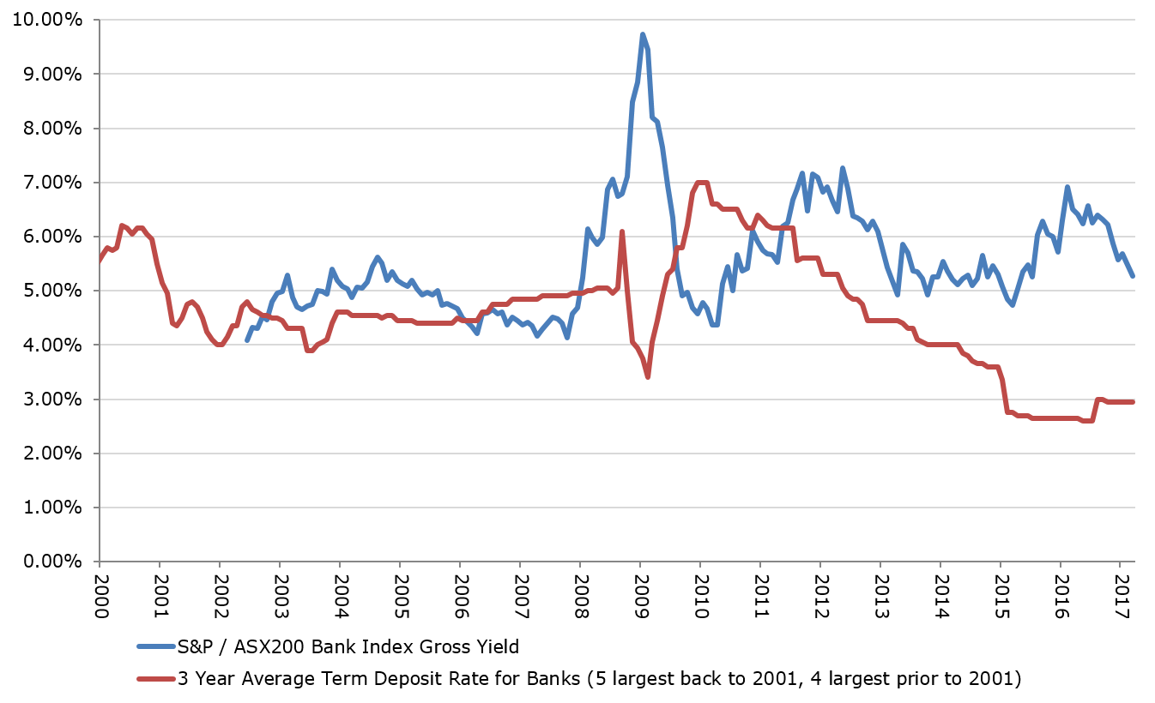
Yields down - but banks still ok?
Source: Bloomberg, RBA
Notes:
Chart data is 3 year average term deposit rate for banks (5 largest back to 2001, 4 largest prior to 2001)
v
Dividend yields on ASX banks index
Source: Bloomberg, RBA as at 31 March 2017
** Is the bank yield net dividend or is it grossed up for imputation credits?
Bank yield is cash dividend (net) only which excludes imputation credits
** Note data on bank bad debt rates – increasing? Vs historical levels?
Bank bad debts are on the rise but still below GFC levels

Slide 8
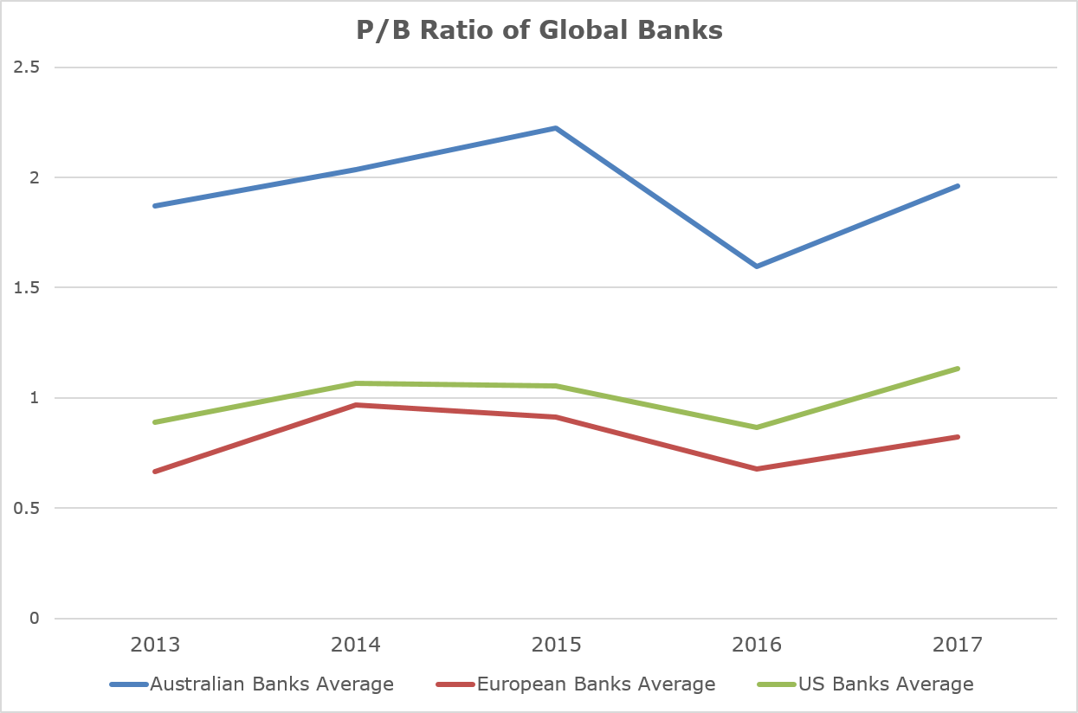
The world’s most expensive ….
Source: Bloomberg
Notes:
World’s most expensive
Typically banks 1.0-1.2 times assets
** How do Aust’s four major banks rank in list of largest companies in the world?
** Are our banks the most valuable in the world?
Source: Bloomberg as at 31 March 2017

Slide 9
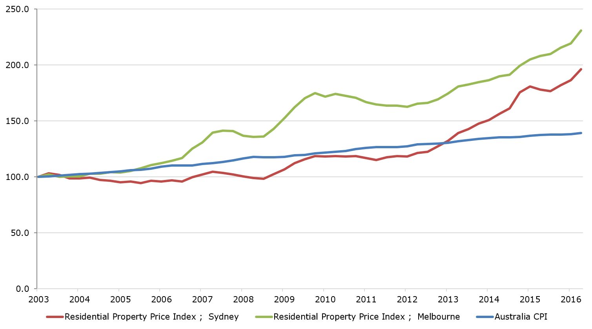
Property is expensive
Source: Bloomberg, ABS
Notes:
Residential property prices run hard
Last 10 years Sydney +100%
Melbourne +90%
Canberra +40%
All other cities below compounding inflation
Problem for resi property prices and the banks that lend to them
Land – not making any more of it!
Units – be wary
Detroit topics ……
Source: Bloomberg and ABS as at 31 Dec 2016

Slide 10
The question of interest rates

Slide 11
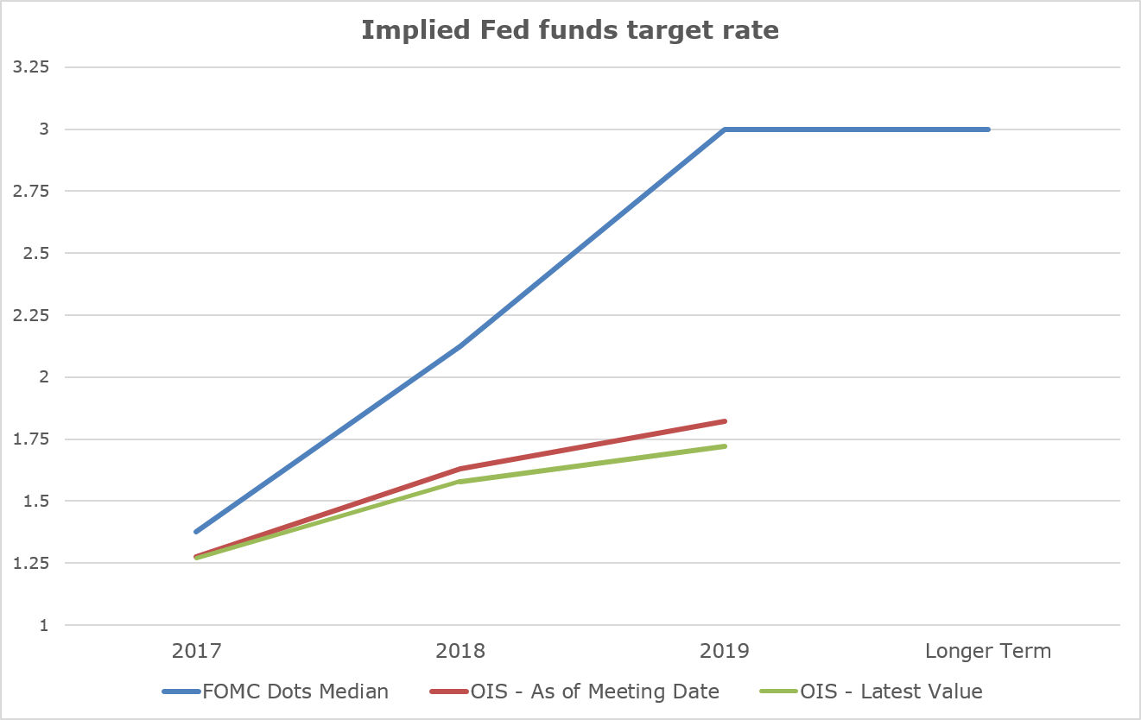
All eyes are on the US
Source: Bloomberg
Notes:
Rates are going up ….. Regularly
Latest unemployment 4.5%
Only below 4% once briefly in last half century
All that easy money will be allowed to quietly mature
Remember Quantitative Easing
The Tapering?
Source: Bloomberg as at 31 March 2017

Slide 12
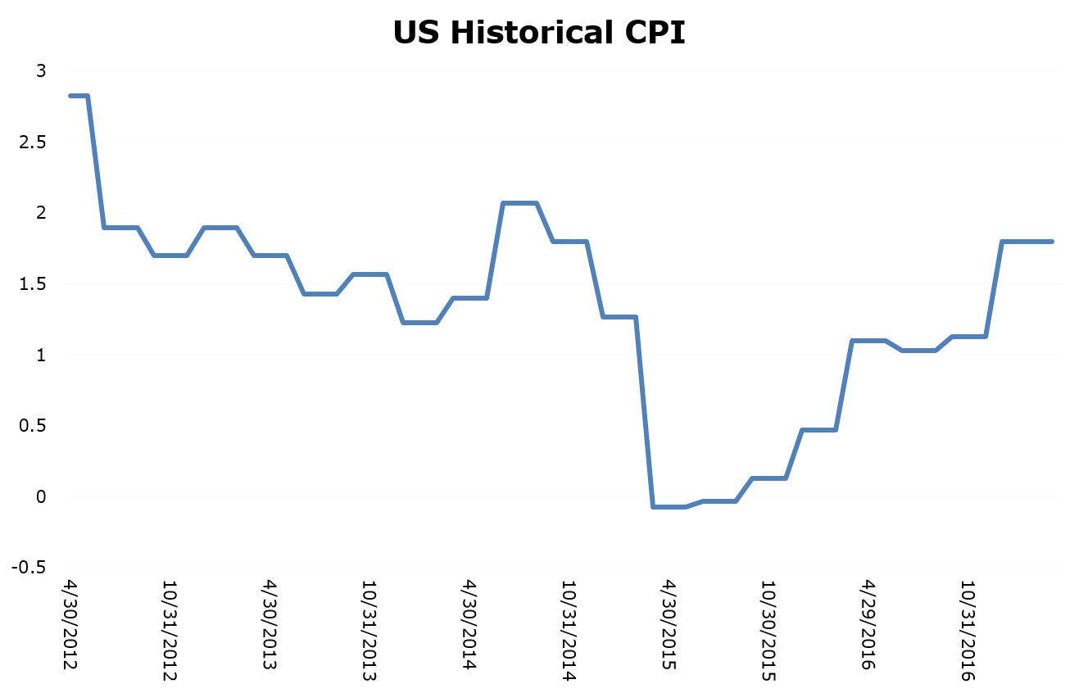
US inflation
Source: Bloomberg
Notes:
Inflation is back
US economy 25% of global – it matters
China 15%
Japan 6%
Germany 5%
Source: Bloomberg as at 31 March 2017

Slide 13
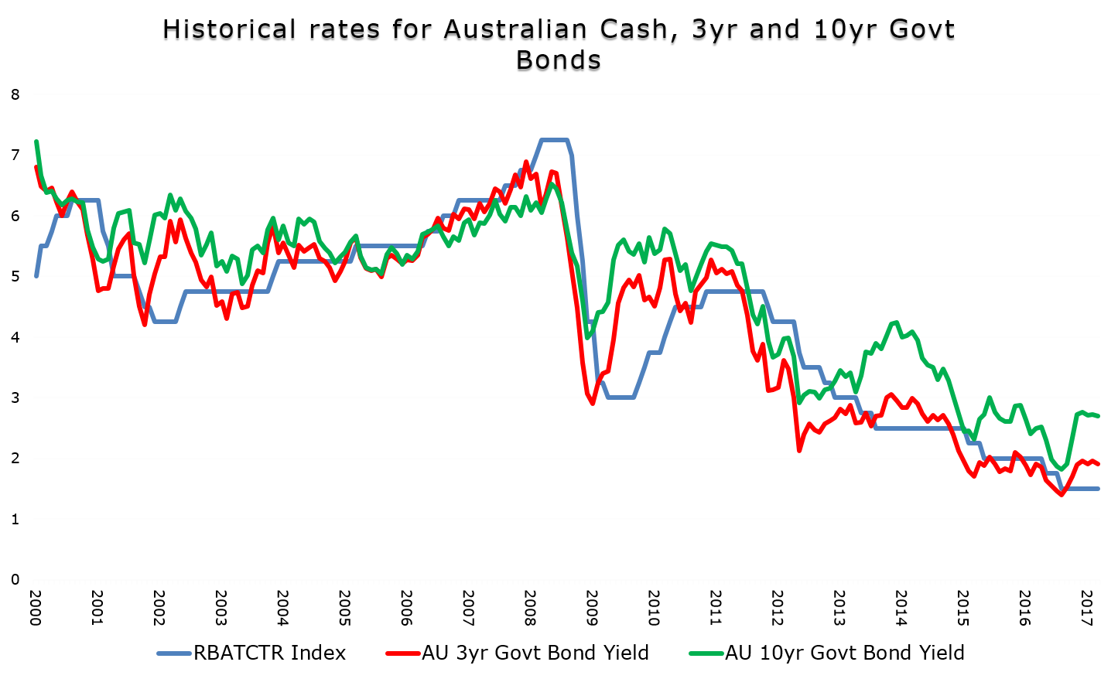
What is happening in Australia
Source: Bloomberg
Notes:
Interest rate party is over
Don’t worry about RBA
Cost of funds globally on rise
The question is WHEN rates kick up here
Rates will run away from you
They often do with the RBA
Source: Bloomberg as at 31 March 2017

Slide 14
Leading share markets
 | 2007/08 Peak | 31 March 2017 | % Change
ASX 200 | 6,754.1 | 5,864.9 | -13.2%
Tokyo Topix | 1,774.9 | 1,512.6 | -14.8%
German DAX | 8,067.3 | 12,312.9 | 52.6%
Dow Jones | 13,930.0 | 20,663.2 | 48.3%
S&P 500 | 1,549.4 | 2,362.7 | 52.5%
FTSE | 6,721.6 | 7,322.9 | 8.9%
Source: Bloomberg
Notes:
*** Can we delete Euro Stoxx and insert German market DAX?
Source: Bloomberg as at 31 March 2017

Slide 15
Where to from here?
Notes:
This is the backdrop
Interesting but unhelpful
Need to decide where to from here
Evolution not revolution
But is going to get noisy, and quickly

Slide 16
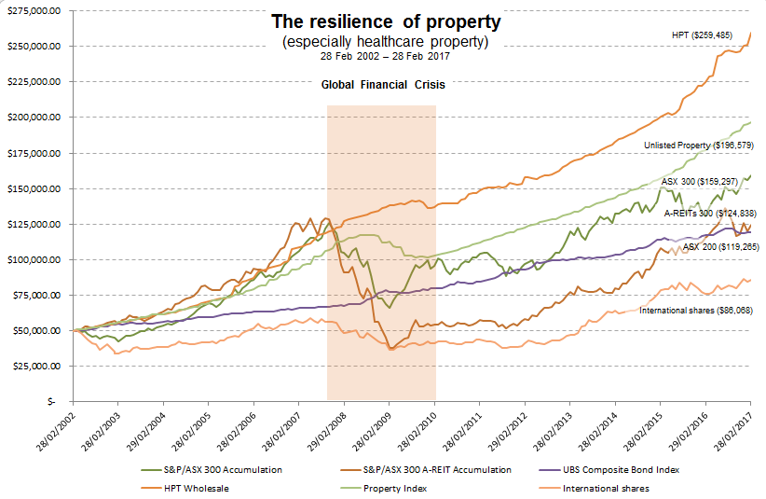
Still value in commercial property
Source: Australian Unity Wealth, Bloomberg, March 2017. Australian Shares (S&P/ASX 300 Accumulation Index), Listed Property (S&P/ASX 300 A-REIT Accumulation), Fixed interest (UBS Composite Bond Index), Direct Property Index (PCA/IPD Pooled Property Fund Index – Unlisted Retail), International shares (MSCI All Countries ex Aust UnHedged in $AUD). Returns for the Trust are calculated after fees and expenses and assume the reinvestment of distributions. Inception date for the Fund is 28 February 2002. Past performance is not a reliable indicator of future performance.
Notes:
All things are relative
Rate changes globally will re-price everything
Yield and interest rates over bought
Go short
Buy at fair value ….. Not based on yield

Slide 17
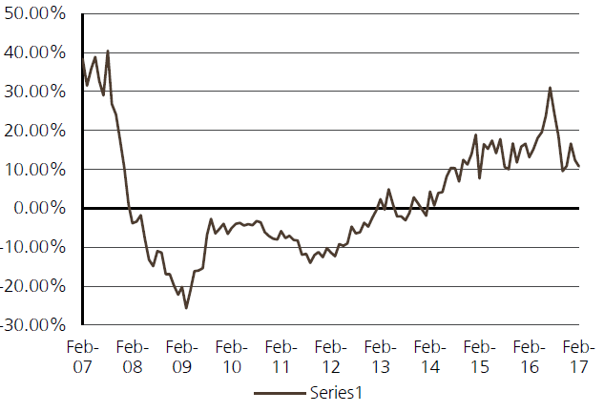
AREITs
NTA (excl. WFD & GMG)
Source: Company Data, UBS
Notes:
Listed property a good example
Capital raising and dilution
Will revert to NTA
Source: Company Data, UBS as at February 2017

Slide 18
Unlisted property
Source: Mercer/IPD
Notes:
Unlisted much less over bought
Choose carefully
Source: Mercer/IPD as at February 2017

Slide 19
Rental yields on commercial property
Source: JLL
Notes:
You’ve got a margin for safety by investing in 6% yields on commercial assets, rather than 3% on resi.
Source: JLL as at 31 March 2017

Slide 20
Shares – small companies
Notes:
Eclipx
· Market leading motor car operating leasing business
· Strong track record of execution and organic market share growth
· Acquisitions likely in a fragmented market
· 12m forward EPS growth of 14% and 14x PE
Corporate Travel Management
· Built a strong business travel franchise locally and now a global footprint to compete for larger contracts
· High degree of revenue visibility
· Using technology to make user experience easy and gain market share
· 12m forward EPS growth of 26% but not cheap at 26x
Oz Minerals
· Mine life extended at Prominent Hill with consistent operational performance
· Very strong balance sheet with >$500m cash
· Developing greenfield mine Carrapateena in SA
· High quality A$ copper exposure
· Fundamentals for copper are the best in the base metals complex over the next 3 years
IDP Education
· Globally leading ‘high stakes’ English testing and student placement franchise
· English testing is an industry with high barriers to entry
· Leveraging student recruitment network through Asia (multi-country) to place students in Australia, USA, Canada and UK (multi-destination)
· EPS growth (12m forward) of 18% but trading at 22x reflecting the quality of the franchise

Slide 21
Shares – large companies
Notes:
CSL
· World class low cost immunoglobulin and haemophilia franchise
· Collection centre lead on competitors will give cost and scale advantage for three years
· Flu vaccine business on track to achieve break even and operating margins targets
· The best top 20 earnings growth stories in the market but not cheap at 28x and is pricing in some of the positive earnings momentum
Ramsay Health Care
· Demographic tailwinds support the top class execution in hospital industry
· PHI driven beat up on prosthesis has been a drag on the stock but it’s in the final innings
· Brownfields expansions in Australia, volume leverage (despite reimbursement headwinds) in UK and France and leveraging global buying power underpins low to mid-teens earnings growth over the next three years
· CEO transition has been to a company veteran with a solid track record
· Trades on 24x 12m forward PE nearer the bottom of the historical 23-28x range
Fisher & Paykel Health Care
· Ventilation franchise is the core of the buy thesis on the stock
· Masks business for obstructive sleep apnoea (OSA) franchise is also high quality business but getting smaller as ventilation outperforms
· 3-5 year high teens EPS growth story but not cheap at 26x
Aristocrat Leisure
· Gaining market share on the strength of its product quality
· No help as yet from the replacement cycle in the USA
· Digital business has been a strong positive surprise
· Earning momentum is still very strong but the stock is trading at a premium rating of 12m forward PE of 22x

Slide 22
Banks
Source: Bloomberg
Notes:
Aust shares still ok
Healthcare and financials had good run
Banks be careful where its coming from
Ex banks and ex resources is where to look
Source: Bloomberg as at 31 March 2017

Slide 23
Global share markets sector breakdown
 | ASX |  | MSCI World |  | MSCI North America |  | MSCI Europe |  | MSCI Asia
 | % | $Billions | % | $Billions | % | $Billions | % | $Billions | % | $Billions
Consumer Discretionary | 5.8% | 106 | 12.4% | 4,378 | 12.42% | 2,949 | 10.8% | 1,043 | 14.4% | 1,621
Consumer Staples | 7.0% | 128 | 9.8% | 3,482 | 8.93% | 2,120 | 14.0% | 1,356 | 6.0% | 678
Energy | 4.4% | 80 | 6.6% | 2,327 | 7.47% | 1,773 | 7.0% | 673 | 2.9% | 321
Financials | 36.3% | 663 | 17.7% | 6,280 | 15.68% | 3,723 | 20.5% | 1,977 | 19.1% | 2,156
Health Care | 7.5% | 137 | 12.2% | 4,322 | 13.07% | 3,103 | 12.9% | 1,246 | 4.6% | 520
Industrials | 6.8% | 124 | 11.3% | 3,989 | 9.50% | 2,255 | 13.1% | 1,266 | 13.6% | 1,537
Information Technology | 1.2% | 22 | 15.5% | 5,473 | 21% | 5,002 | 4.5% | 430 | 20.7% | 2,334
Materials | 15.8% | 289 | 5.1% | 1,792 | 3.4% | 807 | 8.3% | 798 | 5.4% | 611
Real Estate | 8.3% | 152 | 3.2% | 1,141 | 3.0% | 700 | 1.3% | 129 | 5.2% | 585
Telecommunication Services | 4.2% | 77 | 3.1% | 1,109 | 2.4% | 575 | 4.1% | 399 | 5.4% | 603
Utilities | 2.7% | 49 | 3.2% | 1,134 | 3.1% | 734 | 3.6% | 346 | 2.7% | 309
Total | 100% | 1,827 | 100% | 35,423 | 100% | 23,741 | 100% | 9,662 | 100.0% | 11,278
Source: Bloomberg
Notes:
Source: Bloomberg as at 31 March 2017

Slide 24
Back to your portfolio – what might you do?
Banks
Property
Term deposits
+
diversify away from big banks
+ commercial property
+
mortgage loans
& corporate bonds

Slide 25
Questions?

