Slide 1

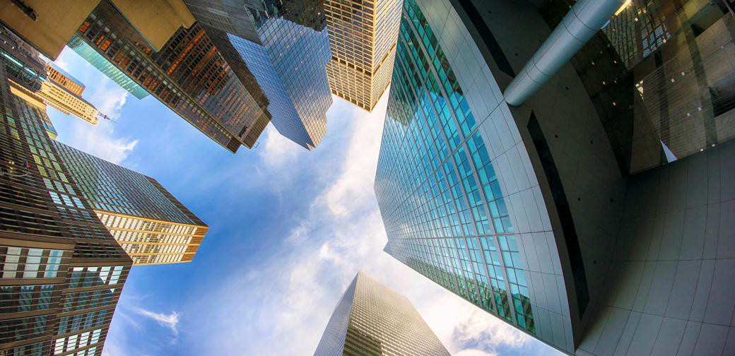
WHOLESALE AUSTRALIAN PROPERTY FUND
APRIL 2018

Slide 2
IMPORTANT
NOTE
The information in this presentation is provided only for the use of advisers/financial planners; it is not intended for investors. This presentation provides a brief overview of some of the benefits of investing in the Wholesale Australian Property Fund ARSN 088 996 392 (the Fund). Further important information about the Fund is contained in the current Product Disclosure Statement (PDS), which investors should read before making a decision about whether to acquire, or continue to hold or dispose of units in the Fund. A copy of the PDS can be obtained from the Fund’s investment manager AMP Capital Investors Limited (ABN 59 001 777 591, AFSL 232 497) (AMP Capital) by calling 131 737 or from the AMP Capital website (www.ampcapital.com.au). National Mutual Funds Management Ltd (ABN 32 006 787 720)(AFSL 234652) (NMFM), the responsible entity of the Fund, and its associates derive income from issuing interests in the Fund, full details of which are disclosed in the PDS.
The adviser/financial planner remains responsible for any advice/services they provide to clients including making their own inquiries and ensuring that the advice/services are appropriate and in accordance with all legal requirements. Therefore, advisers/planners must not attribute any advice/service to AMP Capital or NMFM, nor in any way suggest that AMP Capital or NMFM is the author of any part of that advice/service. This presentation must not be provided to any other person or entity without the express written consent of AMP Capital.
Neither AMP Capital, nor NMFM nor any other company in the AMP Group guarantees the repayment of capital or the performance of any product or any particular rate of return referred to in this document. Past performance is not a reliable indicator of future performance. While every care has been taken in the preparation of this document, neither AMP Capital nor NMFM make any representation or warranty as to the accuracy or completeness of any statement in it including without limitation, any forecasts. This document has been prepared for the purpose of providing general information, without taking account of any particular investor’s objectives, financial situation or needs. Investors should, before making any investment decisions, consider the appropriateness of the information in this document, and seek professional advice, having regard to their objectives, financial situation and needs. This document is solely for the use of the party to whom it is provided.
To the extent of any inconsistency between the English language version of this document and the Mandarin language version of this document, the English language version shall prevail. Applications into the Fund can only be made in English on the Fund’s English language application form, and the English language version of the Fund’s Product Disclosure Statement and Constitution govern investors rights in relation to their investment. Interests in the Fund may not be marketed, offered or sold directly or indirectly to the public in China and neither this document, which has not been submitted to the Chinese Securities and Regulatory Commission, nor any offering material or information contained herein relating to interests in the Fund, may be supplied to the public in China or used in connection with any offer for the subscription or sale of interests in the Fund to the public in China. Interests in the Fund may only be marketed, offered or sold to Chinese institutions which are authorized to engage in foreign exchange business and offshore investment from outside China. Chinese investors may be subject to foreign exchange control approval and filing requirements under the relevant Chinese foreign exchange regulations, as well as offshore investment approval requirements. This information cannot be copied or distributed to persons other than the party to whom they are addressed. This document does not constitute an offer in any jurisdiction outside Australia, or to any person, where it would not be lawful to make such an offer. No action has been taken, or will be taken, to register or qualify units in the Fund or otherwise permit an offering of the Fund in any jurisdiction outside Australia. Persons not in Australia who come into possession of this information should seek advice on its provision and distribution, and observe any relevant legal restrictions on using, providing or distributing it. It is your responsibility to comply with any laws of any country relevant to your application for units in the Fund. Prospective investors should not treat the information as advice on legal, tax or investment matters and should make their own inquiries and consult professional advisers as to applicable laws, regulations and requirements in any particular jurisdiction (including, where the Information is received) and the consequences arising from any failure to comply, as well as the taxation implications of investing in the Fund.
2

Slide 3
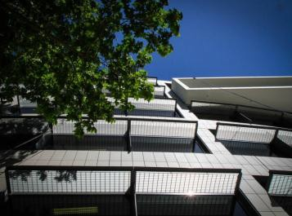
AGENDA
Why direct property?
The Fund in a nutshell
Safe hands – management of the Fund
What you’re buying – portfolio overview
Selected properties – a deep dive
Ways to invest: direct vs fund?
Summary
2

Slide 4
WHY INVEST IN DIRECT PROPERTY?

Slide 5




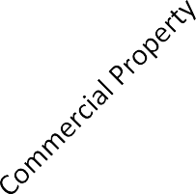




WHY INCLUDE DIRECT PROPERTY
IN A PORTFOLIO?
Australian direct property can provide strong, reliable income
Benefits of investing in direct property
Yield
7.0%
Income
6.0%
6.0%
5.7%
Stability
5.0%
4.5%
4.0%
3.6%
Inflation protection
2.8%
3.0%
2.5%
Diversification
2.0%
2.0%
1.0%
Risk-adjusted returns
-
Past performance is not a reliable indicator of future performance.
Source: Bloomberg, IRESS, Reserve Bank of Australia, IPD Australia Quarterly Digest. Australian listed property: S&P ASX 200 A-REIT Accumulation Index AUD, Australian direct property: IPD Australia Index Australian Equities: S&P/ASX 200 Index, Australian Government bond: Australian 10 year Government Bond, Term deposit: Australian 1-year term deposit rate.
5

Slide 6


WHAT ABOUT
RESIDENTIAL?
Direct property returns
12.0%
Commercial property – great for income
Capital Growth 8.2%
10.0%
Capital Growth 3.1%
Residential – better for capital gain
8.0%
Total Return
Income 7.2%
6.0%
4.0%
Income 2.9%
2.0%
0.0%
Commercial Property
Residential Property
Past performance is not a reliable indicator of future performance
Source: AMP Capital, IPD, Real Estate Institute of Australia. Data based on returns June 1997 – June 2017
6

Slide 7





















INCOME SUPPORTED BY LEASES
TO CORPORATE & GOVERNMENT TENANTS
Income Returns from Commercial Property by Sector
1997-2017
12.0
9.0
Income return
% p.a.
6.0
3.0
0.0
Retail
Office
Industrial
Past performance is not a reliable indicator of future performance Source: MSCI, IPD Australia Quarterly Digest
7

Slide 8
THE FUND IN A NUTSHELL

Slide 9



THE WHOLESALE AUSTRALIAN PROPERTY FUND
IN A NUTSHELL
Fund Objective
The Wholesale Australian Property Fund, established in 1985, aims to provide investors with income and long-term capital growth.
Fund Strategy
Using low debt, invest in diversified portfolio of quality Australian office, retail and industrial buildings. At the same time, hold a portfolio of cash and A-REITs for liquidity.
Vision
To be the premier fund available to smaller investors wanting commercial property.
Why invest?
Attractive returns
Low gearing
Diversification
Access to your investment*
Expertise
Cost competitive
* Please refer to slide 34 and the PDS for the Fund’s withdrawal terms
9

Slide 10
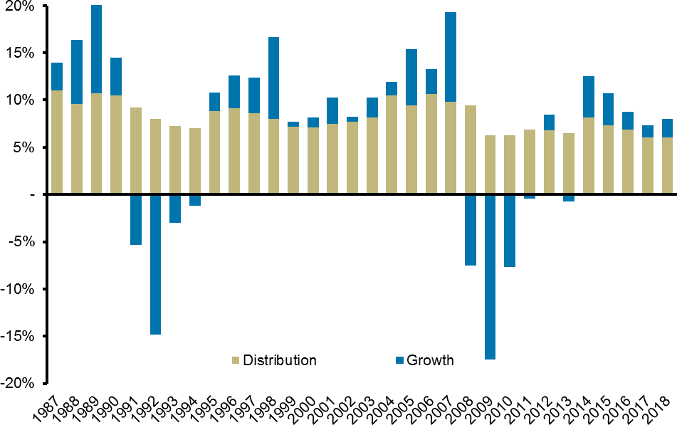
A +30-YEAR TRACK RECORD:
CONSISTENT QUARTERLY DISTRIBUTIONS
Total returns
Since inception: 9.1%^ p.a. Last 3 years: 8.0% p.a.
Last 12 months: 8.0% p.a.
Returns Since Inception
Distributions
Since inception: 8.3% ^ p.a. Last 3 years: 6.3% p.a.
Last 12 months: 6.0% p.a.
Past performance is not a reliable indicator of future performance.
Source: AMP Capital, as at 31 March 2018. Returns shown before tax and after fees.
^ Inception date of the Fund is 31 March 1985
10

Slide 11
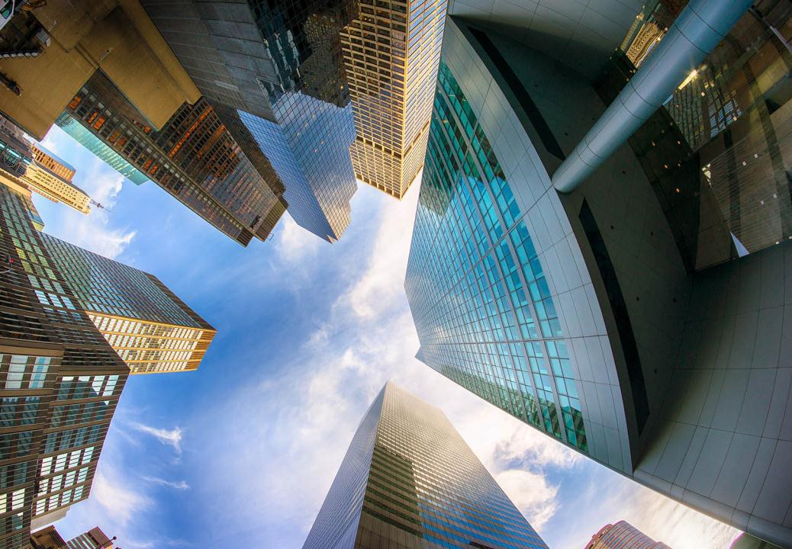
SAFE HANDS – MANAGEMENT OF THE FUND

Slide 12
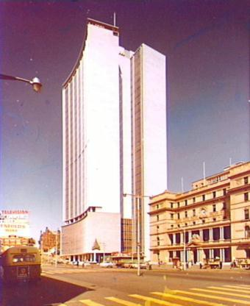
AMP CAPITAL
+50 YEARS OF REAL ESTATE INVESTING
AMP CAPITAL
> One of Australia’s largest investment managers
> Manages over $175 billion* in funds under management
AMP CAPITAL – REAL ESTATE
> Manages over $24 billion* in commercial real estate
> One of the leading property Fund Managers in Asia**
> Over 50 years of experience in property investment
AMP BUILDING, CIRCULAR QUAY
Australia’s first skyscraper developed by AMP in 1962
* As at 30 June 2017 **Asia Property / INREV /ANREV Fund Manager Asia Survey, 2017

Slide 13
AMP CAPITAL SPECIALIST TEAMS:
PROPERTY, AND MANY MORE…
Economics, Markets & Investment Strategy
Compliance & Risk Management
Strategy & Research
Asset Allocation: strategic & tactical Investment Management: Direct, REITs, Cash
Finance/Accounting/Treasury
Capital Management
Debt Advisory Equity
Cash
Retail Products
Distribution Product Management
Marketing
Fund ManaEgPemFent
Capital Transactions
Property Development
Legal Services
Asset Management
Shopping Centres
Office Industrial
Tax / Structuring Services
Property Management

Slide 14

WHAT YOU’RE BUYING – PORTFOLIO OVERVIEW

Slide 15
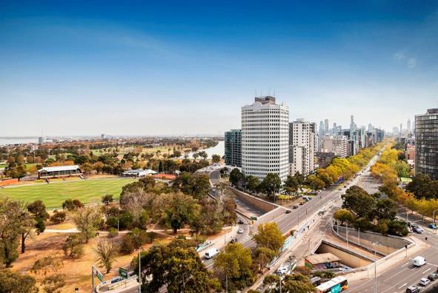
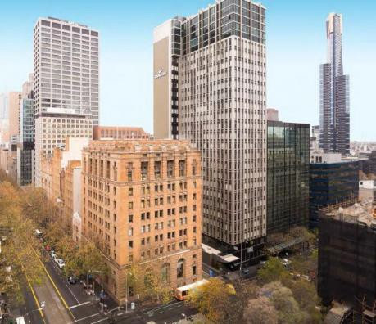
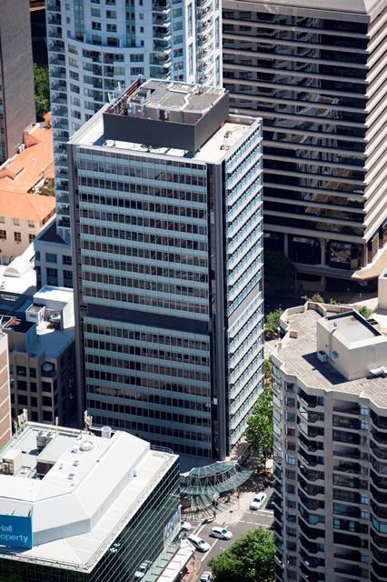
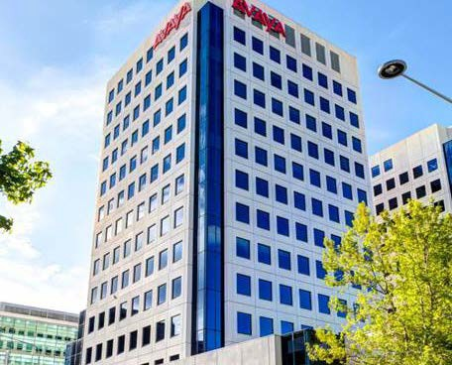
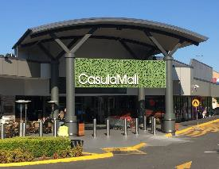
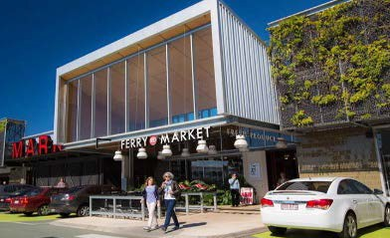
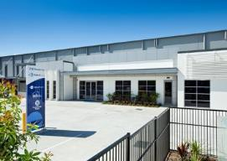
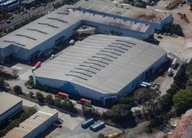
WHOLESALE AUSTRALIAN PROPERTY FUND
BITE-SIZED ACCESS TO A QUALITY COMMERCIAL PROPERTY PORTFOLIO
636 St Kilda Road, Melbourne
425 Collins Street, Melbourne
Casula Mall, Sydney
Brickworks, Gold Coast
12 Moore St, Canberra
7-9 French Avenue, Brendale
121 Evans Road, Salisbury
124 Walker Street, North Sydney

Slide 16






THE FUND OFFERS BITE-SIZED ACCESS
TO A QUALITY +$1.9 BILLION PROPERTY PORTFOLIO
25 commercial properties: office, retail and industrial
98% occupancy rate
+350 corporate / government leases – secure income On average, the leases have 4.2 years to run Quarterly independent valuations
Investing in properties c. $20m – $250m
Small portfolio of A-REITs held for income & liquidity
Source: AMP Capital, as at 31 March 2018. Includes Fund’s A-REIT portfolio.

Slide 17
SPREADING THE RISK -
THE FUND IS HIGHLY DIVERSIFIED
PORTFOLIO BREAKDOWN - SECTORS
DIRECT PORTFOLIO BREAKDOWN - LOCATION
Retail 34.5%
VIC 24.7%
QLD 34.4%
Cash 1.5%
A-REITs 5.6%
Office 35.4%
ACT 3.0%
Industrial 23.0%
NSW 36.0%
SA 1.9%
Source: AMP Capital, as at 31 March 2018

Slide 18









THE COVENANT QUALITY OF THE
PORTFOLIO’S MAJOR TENANTS IS EXCELLENT
Tenant | Property | Expiry | % of Fund Revenue*
 | Bond One, Sydney | June 2020 | 4.1%
 | CentralWest DC, Melbourne | October 2019 | 3.7%
 | Casula Mall, Sydney | September 2022 | 3.0%
 | 2 Second Ave, Adelaide | December 2030 | 2.3%
 | Connect Corporate Centre, Sydney | August 2027 | 2.2%
 | Casula Mall, Sydney | September 2022 | 2.0%
 | Connect Corporate Centre, Mascot | July 2032 | 1.7%
 | Gasworks, Brisbane | August 2033 | 1.7%
 | 33 Park Rd, Brisbane | February 2023 | 1.7%
Source: AMP Capital, sample as at 31 March 2018

Slide 19

CONSISTENTLY HIGH
OCCUPANCY RATE
Average occupancy rate of 97%*
WAPF: Portfolio Occupancy
100%
95%
90%
85%
80%
75%
70%
65%
60%
55%
50%
Occupancy Rate
2007 2008 2009 2010 2011 2012 2013 2014 2015 2016 2017 2018
Source: AMP Capital, as at 31 March 2018, 2007-2018

Slide 20
TRANSPARENT INVESTOR DISCLOSURE
INCLUDING QUARTERLY VALUATION SUMMARY
Property | State | Sector | Val. $m | % of portfolio | Cap rate | Date of valuation | Occ. Rate* | No. of tenants | WALE years
Casula Mall | NSW | Retail | 207.00 | 11.9% | 5.50% | Mar-2018 | 100.0% | 66 | 4.0
Stud Park Shopping Centre | VIC | Retail | 155.00 | 8.9% | 5.75% | Mar-2018 | 99.1% | 68 | 2.6
Gasworks Plaza** | QLD | Retail | 146.80 | 8.4% | 5.00% | Mar-2018 | 100.0% | 36 | 4.7
Brickworks | QLD | Retail | 137.60 | 7.9% | 5.25% | Mar-2018 | 96.2% | 54 | 4.8
124 Walker St, North Sydney | NSW | Office | 118.00 | 6.8% | 5.75% | Mar-2018 | 88.8% | 24 | 2.7
Bond One, Sydney | NSW | Office | 111.00 | 6.4% | 5.75% | Mar-2018 | 100.0% | 5 | 1.7
12 Moore St, Canberra | ACT | Office | 53.00 | 3.0% | 7.75% | Mar-2018 | 91.6% | 18 | 3.0
636 St Kilda Rd, Melbourne | VIC | Office | 100.00 | 5.7% | 6.00% | Mar-2018 | 90.0% | 34 | 2.8
425 Collins St, Melbourne | VIC | Office | 39.20 | 2.2% | 5.00% | Mar-2018 | 100.0% | 5 | 2.9
199 Grey St, Brisbane | QLD | Office | 93.00 | 5.3% | 6.75% | Mar-2018 | 100.0%* | 14 | 4.1
Gasworks Workspace, Brisbane | QLD | Office | 72.50 | 4.2% | 6.25% | Mar-2018 | 100.0% | 9 | 4.7
33 Park Rd, Brisbane | QLD | Office | 49.30 | 2.8% | 7.25% | Mar-2018 | 100.0% | 14 | 3.8
Stanley House, Brisbane | QLD | Office | 28.00 | 1.6% | 6.15% | Mar-2018 | 100.0% | 2 | 4.4
Connect Corporate Centre, Blg 1 | NSW | Industrial | 46.00 | 2.6% | 5.75% | Mar-2018 | 100.0% | 5 | 6.6
Connect Corporate Centre, Blg 2 | NSW | Industrial | 102.00 | 5.9% | 5.25% | Mar-2018 | 100.0%* | 5 | 11.0
1B Unwin St, Rosehill | NSW | Industrial | 26.90 | 1.5% | 7.00% | Mar-2018 | 100.0% | 2 | 1.2
20 Holbeche Rd, Arndell Park | NSW | Industrial | 16.40 | 0.9% | 6.50% | Mar-2018 | 100.0% | 1 | 4.9
Central West DC, Laverton North | VIC | Industrial | 52.85 | 3.0% | 6.75% | Mar-2018 | 100.0% | 1 | 1.5
704 Lorimer St, Port Melbourne | VIC | Industrial | 40.00 | 2.3% | 5.75% | Mar-2018 | 97.1% | 6 | 5.2
2 Pound Rd West, Dandenong | VIC | Industrial | 20.00 | 1.1% | 6.75% | Mar-2018 | 100.0% | 2 | 1.9
200 Greens Rd, Dandenong | VIC | Industrial | 23.85 | 1.4% | 6.50% | Mar-2018 | 100.0% | 3 | 4.5
121 Evans Rd, Salisbury | QLD | Industrial | 33.00 | 1.9% | 7.75% | Mar-2018 | 100.0% | 1 | 2.0
Acacia Gate Industrial Estate | QLD | Industrial | 20.00 | 1.1% | 7.75% | Mar-2018 | 69.0% | 4 | 2.4
7-9 French Ave, Brendale | QLD | Industrial | 18.60 | 1.1% | 7.25% | Mar-2018 | 100.0% | 1 | 3.8
2 Second Ave, Mawson Lakes | SA | Industrial | 32.65 | 1.9% | 7.50% | Mar-2018 | 100.0% | 1 | 12.7
Total |  |  | 1,742.7 | 100% | 6.0% |  | 97.6% | 385 | 4.2
Source: AMP Capital, as at 31 March 2018 * Occupied areas include those subject to a rental guarantee ** Excludes extension to the centre which is currently under construction and is expected to settle in Q4/2018
20

Slide 21
WAPF OFFERS A ‘LOW-DEBT’
COMMERCIAL PROPERTY FUND OPTION
Target Gearing
> 0-15% of gross assets
Allowable Gearing **
> Max. of 25% of gross assets at the time the debt is drawn
Debt Sourcing
> Debt is sourced from the major Australian banks
> The Fund’s interest rate is currently 3.13%
BANK FACILITIES | Westpac | NAB | Total
Facility size: | $250 million | $200 million | $450 million
 | $125 million 3 year, July 2019 $125 million 5 year, July 2021 | $200 million 3 year, Feb 2021
Tranches:
Amount drawn: | $125 million | $175 million | $300 million
Approx. interest rate (on drawn debt): | 3.13% | 3.13% | 3.13%
Line fee (on undrawn debt): | 0.54% | 0.46% | 0.53%
Fund Gearing: |  |  | 15.9%
* Source: AMP Capital, as at 31 March 2018 ** This should be read in conjunction with the Fund’s Product Disclosure Statement (PDS)

Slide 22
RISKS OF
INVESTING*
Property investments
Share market investments Interest rates
Gearing Liquidity Derivatives
Fund termination
* This slide is to be read in conjunction with the Product Disclosure Statement (PDS) for the Fund, dated 22 February 2018

Slide 23
5-YEAR
FUND REVIEW

Slide 24
FIVE YEAR RETURNS:
DISTRIBUTION AND GROWTH
5-year Returns
12%
5-Year Returns (2013-2017)
Distribution: Growth: Total:
7.0%
2.3%
9.3%
10%
8%
6%
Long term returns
> Expected to be 7-9%
4%
2%
-
2013
2014
2015
2016
2017
Distribution
Growth Return
Source: AMP Capital, as at 31 December 2017. Returns shown before tax and after fees.

Slide 25
BROAD INVESTOR SUPPORT
HAS FACILITATED INCREASED DIVERSIFICATION
Diversification by Asset: March 2014
ACT 10%
(1)
Diversification by Asset: 2018
ACT
AREITs 5%
QLD 7%
(1)
SA 2%
(1)
3%
(1)
NSW 34%
(7)
NSW 74%
(5)
VIC 9%
(2)
QLD 32%
(9)
VIC 23%
(7)
From: 9 properties in 2014 …
To: … 25 properties today

Slide 26
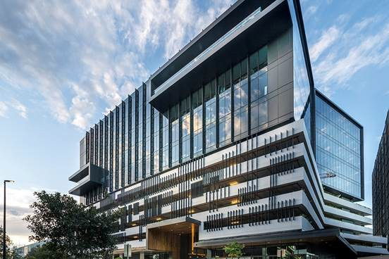
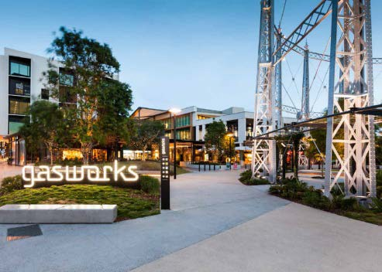
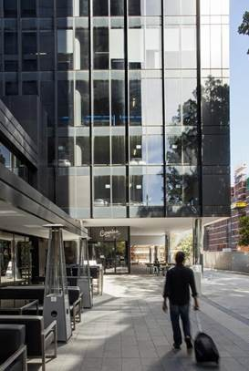
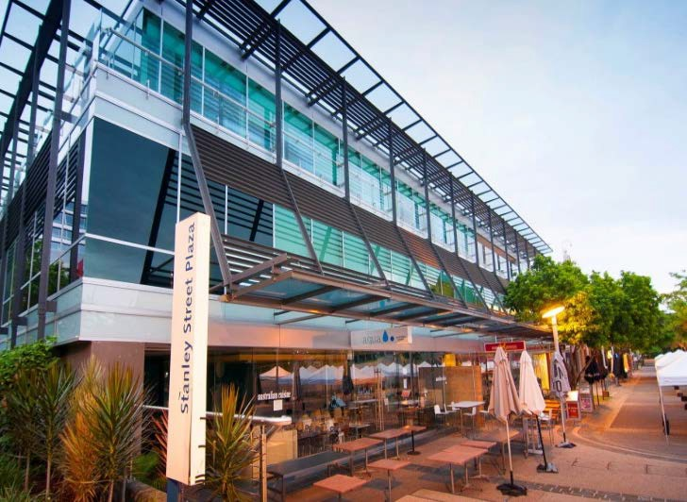
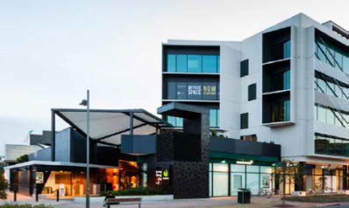
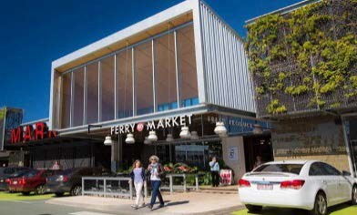
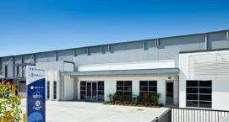
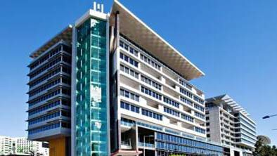
PORTFOLIO REJUVENATION:
ACQUISITIONS HAVE INCREASED QUALITY OF THE PORTFOLIO
Connect Corporate Centre B2 (2017)
Gasworks Plaza (2014-2018)
Gasworks Workspace (2016)
Brickworks (from 2004)
Stanley House (2008)
Brendale (2012)
199 Grey St (2008)
Corporate Connect Centre B1 (2016)
* (20XX) = year of construction or major refurbishment

Slide 27
TOP 10 TENANTS ACCOUNT FOR ONLY 25% OF REVENUE:
EXPOSURE MORE THAN HALVED
Diversification by Tenant:
Top 10 tenants as % of Fund Revenue
70.0%
60.0%
50.0%
40.0%
30.0%
20.0%
10.0%
-
Mar-2014
Mar-2018
Tenant base:
up 250% from 110 tenants to 385 tenants. Top 10 reduced from 60% to 25%.

Slide 28
DEBT:
LOWER, CHEAPER, LONGER
18.0%
4.50%
0.90%
2.3
17.5%
4.00%
0.80%
2.2
3.50%
0.70%
2.2
17.0%
3.00%
0.60%
2.1
16.5%
2.50%
0.50%
2.1
16.0%
2.00%
0.40%
0.30%
2.0
1.50%
15.5%
2.0
1.00%
0.20%
15.0%
0.50%
0.10%
1.9
14.5%
Mar-14 Mar-18 Debt Ratio
0.00%
Mar-14 Mar-18 Interest Rate
0.00%
1.9
Mar-14 Mar-18 Tenor (years)
Mar-14
Mar-18
Credit Line
Increased Scale & Quality : has assisted in getting cheaper debt on longer tenor with multiple banks

Slide 29
ACQUISITIONS:
HOW TO BUY IN A COMPETITIVE MARKET

Slide 30
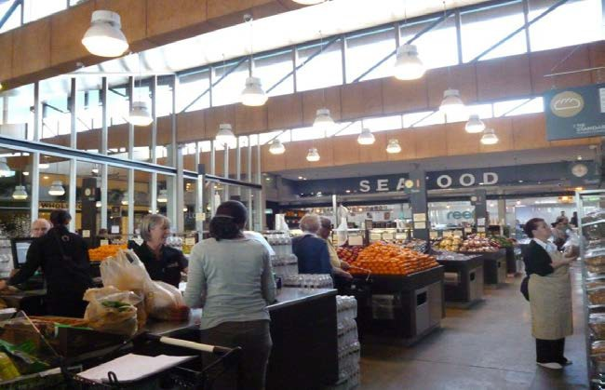
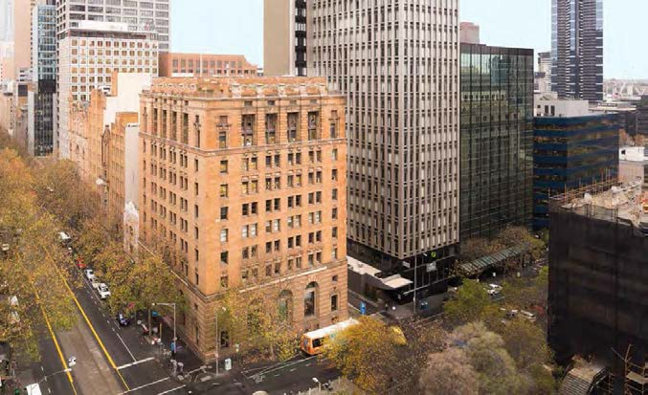
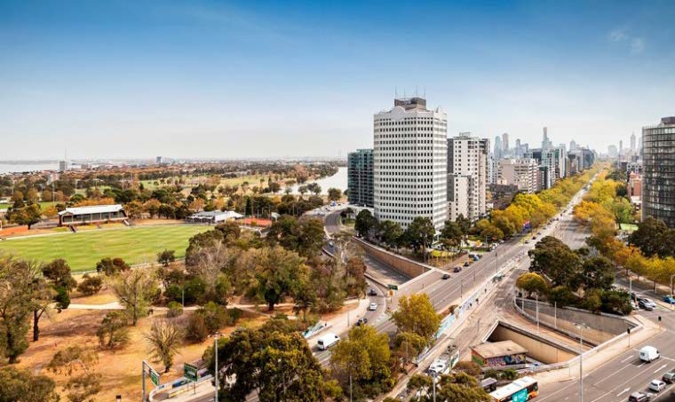
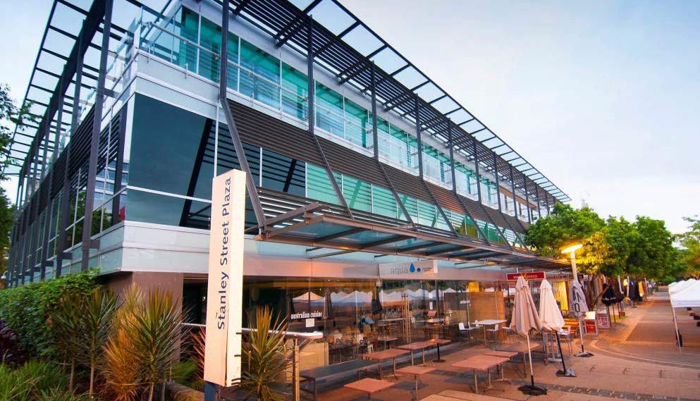
SELECTIVE ACQUISITIONS
>$8 BILLION OPPORTUNITIES REVIEWED IN 2016 AND 2017
BE ABLE TO ACT QUICKLY
BE THOROUGH IN DUE DILIGENCE
Brickworks, Gold Coast
425 Collins Street, Melbourne
CAPABILITY TO STRUCTURE A TRANSACTION
STRONG RELATIONSHIPS: OFF-MARKET DEALS
636 St Kilda Road, Melbourne
Stanley House, South Brisbane

Slide 31
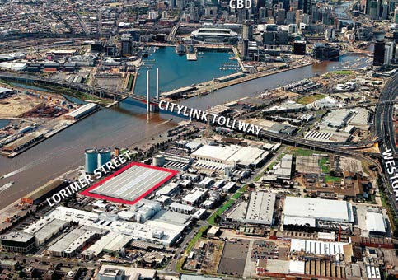
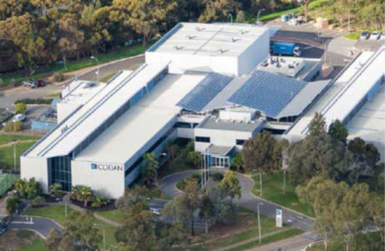
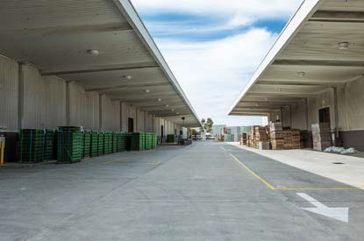
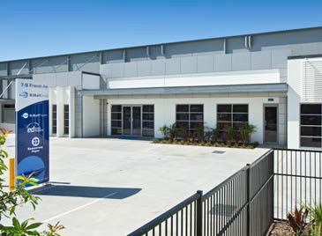
SOME OF THE THINGS WE LOOK FOR
WHEN BUYING …
REDEVELOPMENT POTENTIAL YIELD PLAY
704-744 Lorimer St, Port Melbourne
2 Second Avenue, Adelaide
CONSTRUCTION QUALITY
TENANT COVENANT
Central West DC, Laverton North
7-9 French Avenue, Brendale

Slide 32
SELECTED PROPERTIES
– A DEEP DIVE

Slide 33
GASWORKS PLAZA
BRISBANE, QLD
Gasworks Plaza is comprised of a retail precinct anchored by a full-line Woolworths and accompanied by approximately 30 speciality tenancies, which are largely food, beverage and lifestyle based. The sale productivity of the property is excellent and average rents are below market levels.
The property is located approximately 2.5 kilometres north-east of the Brisbane CBD in one of the city’s fastest growing suburbs. This precinct is also benefiting from a growing workforce as small scale industrial buildings are converted to large office towers.
Another six tenancies are currently being developed and will be purchased later in 2018. These have been designed to a very high specification and are expected to attract leading food and dining operators.
Valuation: $169.5m *
Lettable area: 8,700 m²
Occupancy: 100%
WALE: 4.7 years *
Major tenants: Woolworths
* Source: AMP Capital, as at 31 March 2018

Slide 34
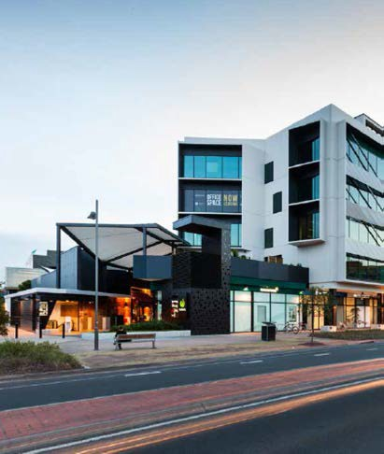
GASWORKS WORKSPACE
BRISBANE, QLD
Gasworks Workspace consists of two fully-let, low rise buildings totalling 8,994sqm with 95 car spaces. Tower A has a 5-star NABERS rating and has full height external glazing which provides for good natural light. The offices position, directly over Gasworks Plaza, offers tenants excellent amenity and casual dining options.
The property is full leased to a combination of private and government tenants.
Valuation: $72.5m *
Lettable area: 8,994 m²
Occupancy: 100%
WALE: 4.0 years *
Major tenants:
National Heavy Vehicle Regulator, Defence Housing Australia, Dentsu Aegis
* Source: AMP Capital, as at 31 March 2018

Slide 35
CONNECT CORPORATE CENTRE, BUILDING 2
MASCOT, NSW
The property is situated in the established commercial precinct of Mascot, approximately 8 kilometres south of the Sydney CBD. Mascot forms part of the Sydney railway network and is in the vicinity of both the Sydney Domestic and International Airport terminals and Port Botany, Sydney’s major shipping container terminal. Its proximity to major infrastructure and its accessibility to the workforce living in Sydney’s eastern and southern suburbs means that Mascot attracts a broad range of government and private tenants from a diverse group of industries.
The building comprises a recently completed tower containing ground floor retail, car parking across three levels and modern office accommodation on levels 7-11.
Valuation: $102.0m *
Lettable area: 11,390 m²
Occupancy: 100% **
WALE: 11.0 years *
Major tenants: Commonwealth of Australia, Kone Elevators
* Source: AMP Capital, as at 31 March 2018 ** Includes areas subject to a rental guarantee or income support

Slide 36
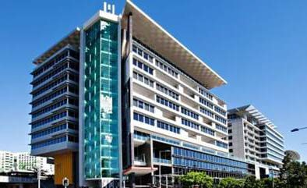
199 GREY STREET
SOUTH BRISBANE, QLD
199 Grey Street is an A-grade office building which was constructed in 2008 and is located in South Brisbane. The property is in close proximity to the recreational, retail and cultural precinct of South Bank. With extensive views of South Bank Parklands, Brisbane River and the Brisbane CBD. The property is also in close proximity to the South Bank train station, numerous bus routes, the City Cat and ferry services.
Valuation: $93.0m *
Site area: 2,041 m²
Lettable area: 11,845 m²
Occupancy: 100% **
WALE: 4.1 years *
Major tenants: State of Queensland, KBR, UGL
* Source: AMP Capital, as at 31 March 2018 ** Includes areas subject to a rental guarantee or income support

Slide 37

BRICKWORKS
GOLD COAST, QLD
The Brickworks Centre comprises a 15,183 square metre single level lifestyle centre which offers fresh food markets eateries, furniture, homewares and boutique retailing. Major tenants include Freedom Australia, TK Maxx, King Furniture and Chemist Warehouse. Most of the tenants have annual rent escalations of 4-5% built into their leases.
The property is located in Southport, approximately 3 kilometres northwest of Surfers’ Paradise. Southport is a Key Regional Centre on the Gold Coast. Population growth in the area is expected to be 2.4% per annum, which is well above the national average. The Gold Coast will hold the 2018 Commonwealth Games and is benefiting from a significant investment in infrastructure over the last few years, including the light rail which passes through Southport.
Valuation: $137.6m *
Site area: 35,427m²
Lettable area: 15,183 m²
Occupancy: 99.9% **
WALE: 4.8 years *
Major tenants: Freedom Furniture, TK Maxx
* Source: AMP Capital, as at 31 March 2018 ** Includes areas subject to a rental guarantee or income support

Slide 38
CONNECT CORPORATE CENTRE, BUILDING 1
MASCOT, NSW
The property is situated in the established commercial precinct of Mascot, approximately 8 kilometres south of the Sydney CBD. Mascot forms part of the Sydney railway network and is in the vicinity of both the Sydney Domestic and International Airport terminals and Port Botany, Sydney’s major shipping container terminal. Its proximity to major infrastructure and its accessibility to the workforce living in Sydney’s eastern and southern suburbs means that Mascot attracts a broad range of government and private tenants from a diverse group of industries.
The building comprises a recently completed tower containing ground floor retail, car parking across four levels and office accommodation on levels 5-8. The net lettable area is approximately 5,640 and there are 141 car spaces. The building is fully-leased to tenants including Qudos, Boston Scientific and JLL.
Valuation: $46.0m *
Site area: 2,385 m²
Lettable area: 5,640 m²
Occupancy: 100%
WALE: 6.6 years *
Major tenants: Qudos, Boston Scientific, JLL
* Source: AMP Capital, as at 31 March 2018

Slide 39
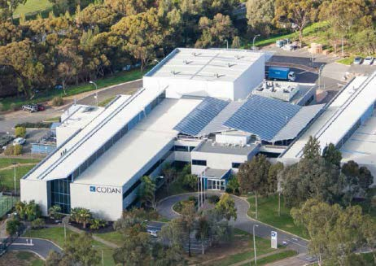
2 SECOND AVENUE
MAWSON LAKES, SA
This property is a campus-style facility located 12 kms north of the Adelaide CBD in a precinct known as ‘Technology Park’. Technology Park includes national and international businesses in the fields of defence, aerospace, advanced electronics and communications.
The property sits on a 3.5 hectare site and is comprised of 8,642 sqm of linked office and warehouse spaces. The complex was constructed in various stages from 1995 and was completely refurbished and extended in 2015 at a cost of over $14 million. There is ample parking and excellent tenant facilities including a tennis court with adjacent gazebo, a gymnasium and a covered outdoor area fitted out with BBQs, a pizza oven, bar and a mounted large-screen television.
It is fully-leased to Codan, an ASX-listed tenant, on a lease which runs through to 2030.
Valuation: $32.65m *
Site area: 34,450 m²
Lettable area: 8,642 m²
Occupancy: 100%
WALE: 12.7 years *
Major tenants: Codan
* Source: AMP Capital, as at 31 March 2018

Slide 40
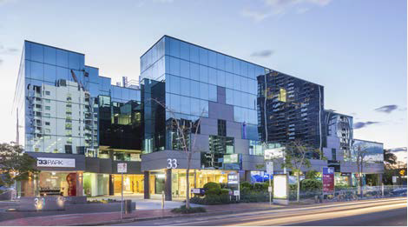
33 PARK ROAD
MILTON, QLD
33 Park Road is a fully-leased office building located in the Brisbane suburb of Milton. Milton is 2 kms from the Brisbane CBD and within this market, Park Road is the premier commercial and retail precinct. The property is well-serviced by public transport being closed to rail, bus and ferry stations. Immediately opposite the property is the iconic alfresco restaurant strip known as Savoir Faire which adds amenity to the area.
The building was constructed in 1989 and consists of ground-floor retail, three levels of modern office space and 187 car spaces.
The building is fully-leased, being one of the few buildings in the precinct with floor plates large enough to attract major tenants.
Valuation:
$49.30m *
Site area:
4,715 m²
Lettable area:
7,245 m²
Occupancy:
100%
WALE:
3.8 years *
Major tenants:
ConocoPhillips, Nautilus Minerals
* Source: AMP Capital, as at 31 March 2018

Slide 41
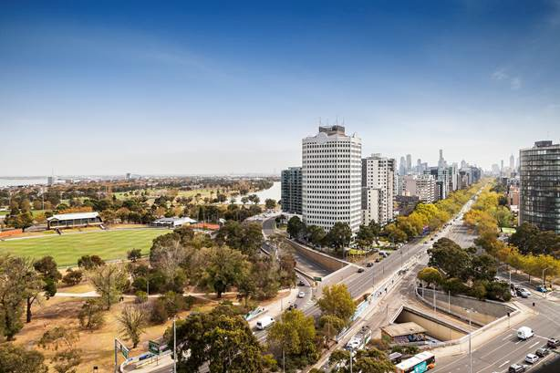
636 ST KILDA ROAD
ST KILDA, VIC
636 St Kilda Road, Melbourne is an iconic 18-level office building prominently situated St Kilda Road, approximately five kilometres from the Melbourne CBD.
The tower is free-standing with four sides of natural light and excellent views of Port Philip Bay and Albert Park. There is a ground-floor café offering indoor and outdoor dining options and 206 car spaces. The property is serviced by the Melbourne tram and rail network and is a short walk from Fitzroy Street’s cafés and restaurants.
In recent years, the building has benefited from substantial refurbishment and capital upgrades to provide a high standard of commercial accommodation. The building is fully-leased and is occupied by over 30 tenants. The leases generally provide for fixed annual rental growth of between 3.50%-4.00%.
Valuation: $100.0m *
Site area: 32,352 m²
Lettable area: 17,050 m²
Occupancy: 90.0% *
WALE: 2.8 years *
Major tenants: Hertz Australia, Diversified Exhibitions
* Source: AMP Capital, as at 31 March 2018

Slide 42
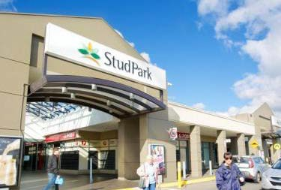
STUD PARK SHOPPING CENTRE
ROWVILLE, VIC
Stud Park Shopping Centre is an established sub-regional shopping centre, located in Rowville approximately 32 kms south east of the Melbourne CBD.
Major tenants include Woolworths, Coles and Kmart and there are 58 specialty stores, a library and car parking for over 1,500 vehicles. The buildings sit on approximately 11 hectares providing the option of future expansion potential.
Incomes in the main trade area are 12% above the Melbourne average and 75% of the specialty tenants have annual rent escalations of 4-5% built into their leases.
Valuation: $155.00m *
Site area: 109,220 m²
Lettable area: 25,573 m²
Occupancy: 100% *
WALE: 2.6 years *
Major tenants: Woolworths, Coles, Kmart
* Source: AMP Capital, as at 31 March 2018

Slide 43
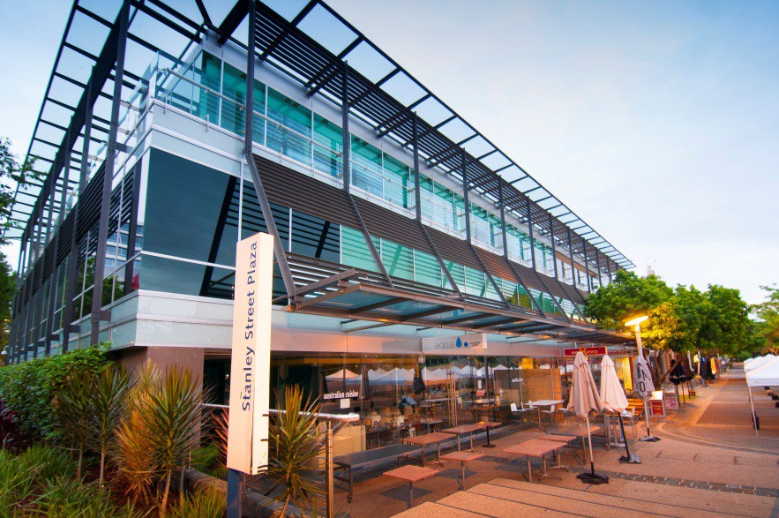
STANLEY HOUSE
SOUTH BRISBANE, QLD
Stanley House is a boutique fully-leased office and retail building which was constructed in 2008.
The property is located in the parklands of Southbank which is adjacent to the Brisbane River. The locality is well-known for its popular cafes and restaurants and is close to the Brisbane Museum, the State Library and the Performing Arts Centre. The Brisbane CBD can be accessed by two footbridges and the area is well serviced by public transport with ferry and rail access.
The retail component of the property is leased to Southbank Corporation until July 2018 and the office space has recently been let to advertising agency Young and Rubicam on a lease that expires in February 2024.
Valuation: $28.00m *
Site area: 1,250 m²
Lettable area: 2,338 m²
Occupancy: 100%
WALE: 4.4 years *
Major tenants: Young and Rubicam, South Bank Corporation
* Source: AMP Capital, as at 31 March 2018

Slide 44
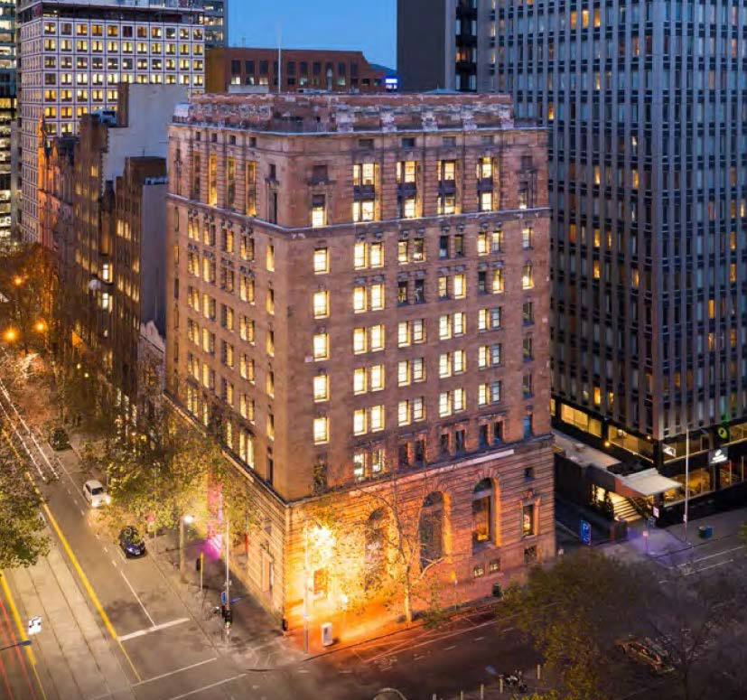
425 COLLINS ST
MELBOURNE, VIC
425 Collins St, Melbourne is a 10-level office building situated on a high profile corner of the Melbourne CBD.
The property comprises 5,380 sqm of office and retail accommodation, a double basement commercial car park and a substantial rear area of surplus land. The building was originally built in 1931 as the Melbourne headquarters of AMP. It features a striking sandstone façade and is one of few buildings of its era to have natural light on three sides.
The property is leased to a range of professional firms including Wisewould Mahony Lawyers, Terra Firm and Serraview. Over time, an opportunity exists to refurbish the floors and upgrade the building services with a view to increasing the rents.
Valuation: $39.2m *
Site area: 1,168 m²
Lettable area: 5,380 m²
Occupancy: 100% *
WALE: 2.9 years *
Major tenants: Wisewould Mahony Lawyers
* Source: AMP Capital, as at 31 March 2018

Slide 45
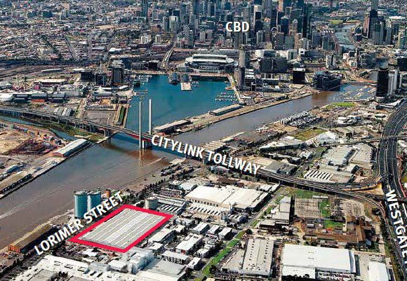
704-744 LORIMER ST
PORT MELBOURNE, VIC
704-744 Lorimer St, Port Melbourne, is an industrial unit estate in Melbourne located approximately 2 kms southwest of the Melbourne CBD. Port Melbourne is currently undergoing a period of widespread gentrification from a traditional industrial hub, to high-tech creative uses.
The property benefits from strong transport links with access to Citylink, Princess Freeway, Westgate Freeway, Monash Freeway and the Western Ring Road. The site is less than 400 metres from the Fisherman’s Bend region which has recently been rezoned for medium and high-density living.
The property comprises an industrial complex featuring various office and warehouse units and was constructed c. 1940s and refurbished and extended in the late 2000s. The property is fully-leased with St Ali. Ability Press, the largest tenant, having recently committed to a new 10-year lease.
Valuation: $40.0m *
Site area: 33,440 m²
Lettable area: 25,386 m²
Occupancy: 97.1% *
WALE: 5.2 years *
Major tenants: Ability Press, Boral
* Source: AMP Capital, as at 31 March 2018

Slide 46
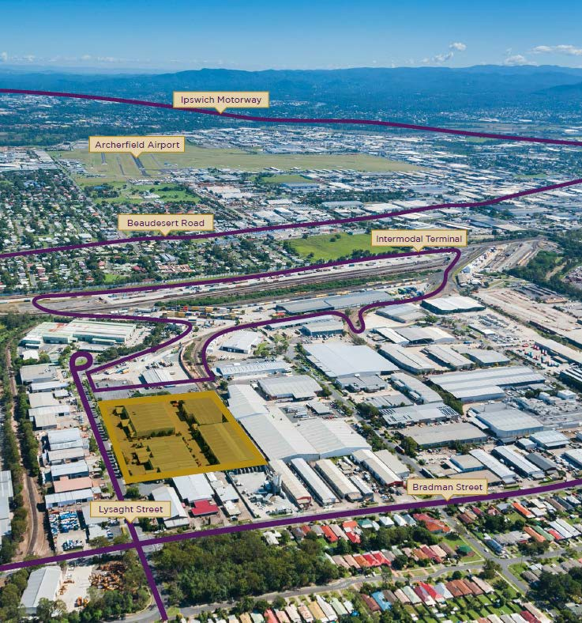
ACACIA GATE INDUSTRIAL ESTATE
ACACIA RIDGE, QLD
Acacia Gate Industrial Estate is located in Acacia Ridge, approximately 16 kms south of the Brisbane CBD, and is well serviced by key infrastructure including the freight rail network, major arterial roads and the Port of Brisbane.
The property consists of a multi-unit estate comprising four separate office and warehouse buildings. The estate is currently divided into eight tenancies across a total building area of 18,488 sqm. The warehouses are highly functional, offering high bay clearance and the flexibility to be divided or merged into various sized tenancies.
Valuation: $20.0m *
Site area: 32,352 m²
Lettable area: 18,488 m²
Occupancy: 69% *
WALE: 2.4 years *
Major tenants: KAB Seating, BP Australia
* Source: AMP Capital, as at 31 March 2018

Slide 47
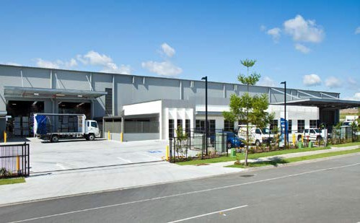
7-9 FRENCH AVENUE
BRENDALE, QLD
The property is located approximately 18 kilometres north of the Brisbane CBD and is situated in a well-established and fast growing northern industrial precinct.
The improvements were constructed in 2012 to a high standard and include a warehouse area of 11,720 sqm and an office area of 562 sqm.
The property is leased to BJ Ball Group on a 10 year lease expiring in 2022, one of the largest distributors of paper and packaging products in Australasia.
Valuation: $18.6m *
Site area: 19,120 m2
Lettable area: 12,282 m2
Occupancy: 100% *
WALE: 3.8 years *
Major tenants: BJ Ball
* Source: AMP Capital, as at 31 March 2018

Slide 48
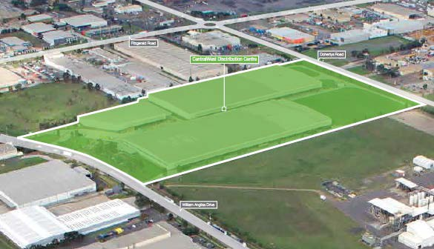
CENTRALWEST DISTRIBUTION CENTRE
LAVERTON NORTH, VIC
CentralWest Distribution Centre is a modern industrial facility located in Laverton North, approximately 16 kms west of Melbourne’s CBD.
The estate features three warehouse facilities and land for potential future development. The warehouses are leased to glass manufacturer, ACI Operations Pty Ltd. ACI has been a tenant since 2002.
Valuation: $52.85m *
Site area: 121,000 m2
Lettable area: 56,112 m2
Occupancy: 100% *
WALE: 1.5 years *
Major tenants: ACI Operations
* Source: AMP Capital, as at 31 March 2018

Slide 49
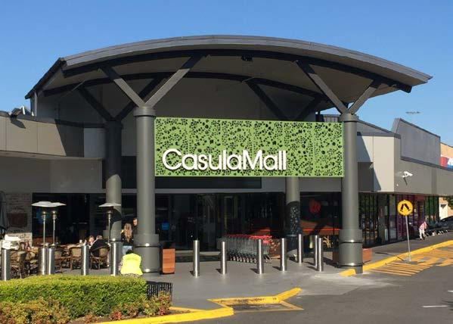
CASULA MALL
CASULA, NSW
Casula Mall is located in Sydney’s south-west growth corridor and is widely regarded as one of the best sub-regional shopping centres in Australia.
The centre is anchored by Coles, Kmart and Aldi, which all perform very strongly. There are over 6 million visits per annum to Casula Mall and the centre generates nearly 1.5 times the sales volumes of comparable centres.
The centre was opened in 1986 and purchased by the Fund in 1988 for
$27 million and has been recently valued at $201 million.
Valuation: $207.00m *
Site area: 52,220 m²
Lettable area: 20,057 m²
Occupancy: 100%
WALE: 4.0 years *
Major tenants: Coles, Kmart, Aldi
* Source: AMP Capital, as at 31 March 2018

Slide 50
WAYS TO INVEST IN PROPERTY: DIRECT VS FUND

Slide 51


THE WHOLESALE AUSTRALIAN PROPERTY FUND
IS AN EFFECTIVE WAY TO ACCESS DIRECT PROPERTY
 | Direct ownership | Australian Property Fund
Diversification
No. of properties | 1 property | 25 properties
Value of properties | say, $1m | $1,700 million
Markets | 1 market | Australia-wide
No. of tenants | 1-2 tenants | +350 tenants
Management time | control but time-consuming | +500 professionals
Types of properties | small properties | office, retail, industrial
Transactions | agents / auctions | specialised team / off-market
Debt | c. 5.50% | current rate: 3.13%*
Transaction costs | c. 6-8% | no entry / exit costs
Liquidity | at least 6 months | monthly**
* Applies to drawn debt as at 31 March 2018 **Note, the constitution allows withdrawal requests to be paid within 12 months or longer in some circumstances. Quarterly withdrawals are currently capped at 5% of NAV
51

Slide 52
SUMMARY

Slide 53



THE FUND HAS BEEN RATED
BY TWO INDEPENDENT RESEARCHER HOUSES
Independent research ratings
Ratings by independent researchers:
Lonsec: Highly Recommended
Zenith Investment Partners: Recommended
The Lonsec Rating (assigned December 2017) presented in this document is published by Lonsec Research Pty Ltd ABN 11 151 658 561 AFSL 421445. The Rating is a “class service” (as defined in the Financial Advisers Act 2008 (NZ)) or is limited to “General Advice” and based solely on consideration of the investment merits of the financial product(s). In New Zealand it must only be provided to “wholesale clients” (as defined in the Financial Advisers Act 2008 (NZ)). Past performance information is for illustrative purposes only and is not indicative of future performance. It is not a recommendation to purchase, sell or hold AMP Capital’s product(s), and you should seek independent financial advice before investing in this product(s). The Rating is subject to change without notice and Lonsec assumes no obligation to update the relevant document(s) following publication. Lonsec receives a fee from the Fund Manager for researching the product(s) using comprehensive and objective criteria. For further information regarding Lonsec’s Ratings methodology, please refer to our website at: http://www.beyond.lonsec.com.au/intelligence/lonsec-ratings
The Zenith Investment Partners (“Zenith”) Australian Financial Services License No. 226872 rating (assigned February 2018) referred to in this document is limited to “General Advice” (as defined by the Corporations Act 2001) for Wholesale clients only. This advice has been prepared without taking into account the objectives, financial situation or needs of any individual. It is not a specific recommendation to purchase, sell or hold the relevant product(s). Investors should seek independent financial advice before making an investment decision and should consider the appropriateness of this advice in light of their own objectives, financial situation and needs. Investors should obtain a copy of, and consider the PDS or offer document before making any decision and refer to the full Zenith Product Assessment available on the Zenith website. Zenith usually charges the product issuer, fund manager or a related party to conduct Product Assessments. Full details regarding Zenith’s methodology, ratings definitions and regulatory compliance are available on our Product Assessment’s and at http://www.zenithpartners.com.au/RegulatoryGuidelines
53

Slide 54
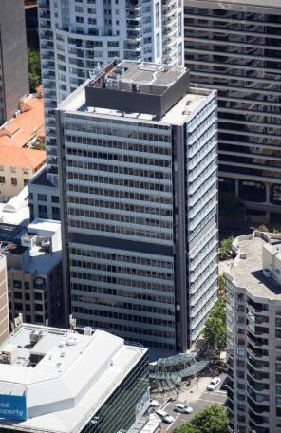
FUND VISION: “TO BE THE PREMIER FUND AVAILABLE TO
SMALLER INVESTORS WANTING ACCESS TO AUSTRALIAN COMMERCIAL PROPERTY RETURNS”
Established fund with a track record dating back to 1985
Attractive returns with average total return 9.1% pa since inception*
Trusted manager with over 50-years’ property investment experience
Direct property fund with 25 commercial properties valued at +$1,700m and the ability to hold some Australian listed property securities and cash to assist in managing returns and liquidity
Diversified exposure with properties located in major metropolitan locations around Australia in the office, retail and industrial markets
Income focus with quarterly distributions to investors underpinned by contractual leases with over 350 corporate and government tenants
Low gearing with debt limited to 25% of gross assets**
Cost competitive with no application fee, no buy/sell spread, no performance fee and no stamp duty payable by new investors on existing fund assets
Transparent reporting provides property and fund level information to investors
Access to your money currently paying withdrawals monthly. (Note, the constitution allows withdrawal requests to be paid within 12 months or longer in some circumstances. Quarterly withdrawals are currently capped at 5% of the net asset value of the Fund).
Available on-platform or for direct investment. Suitable for SMSF funds and Significant Investor Visa (SIV) applicants can access the Fund
124 WALKER STREET, NORTH SYDNEY, NSW
Source: AMP Capital, as at 31 March 2018. Returns shown before tax and after fees and assumes income is reinvested.
^ Inception date of the Fund 31 March 1985 *Past performance is not a reliable indicator of future performance ** As at the date of drawdown
54

Slide 55
APPENDIX

Slide 56
PRODUCT
TERMS*
Fund Term | Open-ended
Investment Objective | To provide income and long-term capital growth.
Asset Allocation | The target asset allocation for the Fund is to hold 75% of its assets as direct property, with the balance of 25% allocated across cash and Australian Securities Exchange (ASX) listed property securities, such as Australian Real Estate Investment Trusts (AREITs) and funds which invest predominantly in AREITs.
Investment Style | The Fund’s asset allocation is based on factors such as the liquidity requirements of the Fund and our expectations of the direct and listed property markets.
Withdrawals | Withdrawal requests are generally processed monthly according to specified withdrawal dates. Generally, withdrawal requests will be satisfied within five business days of the specified withdrawal date, but may take up to 12 months, or longer, as allowed under the Fund’s constitution. Where the amount of funds available for meeting withdrawal requests is not sufficient to fully meet all withdrawal requests relating to a specified withdrawal date, withdrawal amounts may be paid in parts. Furthermore, monthly withdrawals will be capped at 5% of the net asset value of the Fund (although we have discretion to alter this amount). The withdrawal arrangements outlined above only apply while the Fund is liquid as defined under the Corporations Act. Where the Fund ceases to be liquid, including due to changes to the Corporations Act definition of liquid, withdrawals are cancelled and investors will not be able to withdraw from the Fund unless and until the Responsible Entity chooses to make a withdrawal offer to investors.
Borrowing | The Fund’s capital will be managed conservatively, with low borrowings. Where debt is used, it will be used selectively to fund capital expenditure, investments and withdrawals where appropriate. Normally, debt will range from 0-15% but at times the Fund may have higher gearing. The maximum amount the Fund may borrow is 25% of gross assets at the time the debt is drawn.
Distributions | The distribution period is quarterly ending 31 March, 30 June, 31 December and 31 December.
Valuations | Properties will be valued quarterly or any other time the manager deems appropriate.
Fees | Base management fees are 0.42% pa of gross assets plus 4.2% of gross income. There are no performance fees. In the future a performance fee may be payable on underlying funds in which the Fund invests.
Expenses | Fund expenses are estimated to be 0.15% pa of gross assets
* This slide is to be read in conjunction with the Product Disclosure Statement (PDS) for the Fund, dated 22 February 2018

Slide 57
RISKS*
KEY
Investment risks | Investment risks can affect your circumstances in a number of ways, including: The stated aims and objectives of the Fund may not be met The amount of any distribution you receive from the Fund may be irregular, which could have an adverse impact if you depend on regular and consistent distributions to meet your financial commitments Your investment in the Fund may decrease in value, which means you may get back less than you invested Your investment in the Fund may not keep pace with inflation, which would reduce the future purchasing power of your money
Property investments | The Fund’s return may be affected by factors such as demand in the marketplace by investors for property, the demand by tenants for commercial space, rental income levels, the tenants’ ability to service rental payments, the supply of new commercial space, capital expenditure and ongoing expenses for maintenance and repairs, costs and losses associated with natural disasters, or other disasters or events outside of our reasonable control, which prevent the normal operation of the Fund’s assets. The returns from property investments may fluctuate from year to year. The Fund’s direct property investments are generally held over the longer term and considered illiquid, which means that immediate access to your capital investment in the Fund is not guaranteed. Selling commercial property takes three to six months and may take longer in a market downturn.
A-REITs | The value of the Fund’s Australian property securities (A-REITs) may decrease as a result of adverse movements in share markets.
Gearing and the use of debt | The Fund and underlying securities in which the Fund invests may use debt, sometimes referred to as ‘gearing’. Risks with gearing include: Gearing magnifies both gains and losses from the Fund’s investments meaning geared funds may experience larger fluctuations in the value of their investments compared with an ungeared portfolio Changes in interest rates may affect the amount of income available for distribution to investors and/or the capital value of the Fund, and Financing risk including the Fund’s ability to refinance a debt facility on agreeable terms upon the expiry of the original financing term.
Liquidity | From time to time the Fund is likely to require cash to fund asset acquisitions, capital expenditure or withdrawals. This cash may be obtained from a number of sources including the proceeds from application for units in the Fund by new or existing investors, bank debt, the sale of property securities and direct property sales. If these sources are not available at the time required, the Fund’s liquidity level may drop which increases the risk that the Fund may not be able to meet withdrawal requests either in part or in full. Furthermore, quarterly withdrawals will be capped at 5% of the net asset value of the Fund. The Fund’s long-term ability to maintain monthly withdrawals relies on it being able to attract sufficient new applications to offset redemptions. In addition, if the Fund ceases to be liquid for the purpose of the Corporations Act, the Responsible Entity will not meet withdrawals.
* This slide is to be read in conjunction with the Product Disclosure Statement (PDS) for the Fund, dated 22 February 2018

